Slide 1
World War II

Slide 2
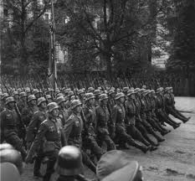
Causes of World War II
Versailles Treaty → Crippled Germany and brought the Nazis to power.
Japanese Militarists desire for natural resources.
Great Depression.

Slide 3
Europe in the 1930s
Hitler annexes Austria.
Hitler annexes Sudetenland (a part of Czechoslovakia that contained many ethnic Germans.
Soviets protest and offer to protect Czechs, but Poland, Britain, and France block this.
British and French assist Hitler in annexing Sudetenland.
Make Hitler promise not to annex anything else.
Hitler seizes all of Czechoslovakia six months later.

Slide 4
Nazi-Soviet Non-Aggression Pact
Soviets had tried to ally with Britain and France against Germany, to no avail.
Stalin and Hitler agree not to attack one another.
Stalin does not trust Hitler, but wants to buy time to build up their defenses.
Believed Hitler would invade the USSR by 1946.

Slide 5
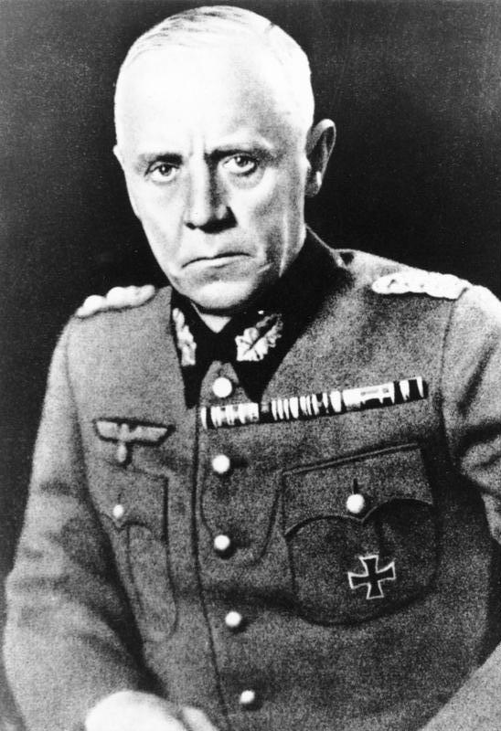
Last Chance to Stop Hitler
German High Command feared Hitler.
Believed that Hitler would start another World War that would destroy Germany.
60 German High-Level Officers contact the British with an offer.
German military will overthrow Hitler and destroy the Nazis.
British will provide public support for the coup and help organize elections in Germany.
British refuse.

Slide 6
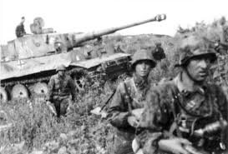
Blitzkrieg!
German generals realize that they have to come up with alternative tactics: Blitzkrieg
Three-phase attack: Aircraft, tank, and infantry → MOBILITY IS KEY
Germany cannot win a static, drawn-out war → Eventually the global empires will bury Germany.

Slide 7
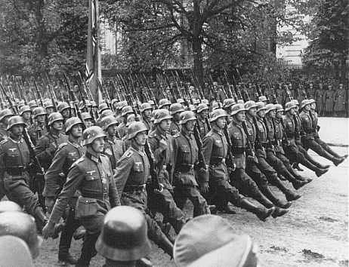
Poland
September of 1939.
Germany invades Poland in 1939 → Two weeks to conquer Poland.
Britain and France declare war on Germany.

Slide 8
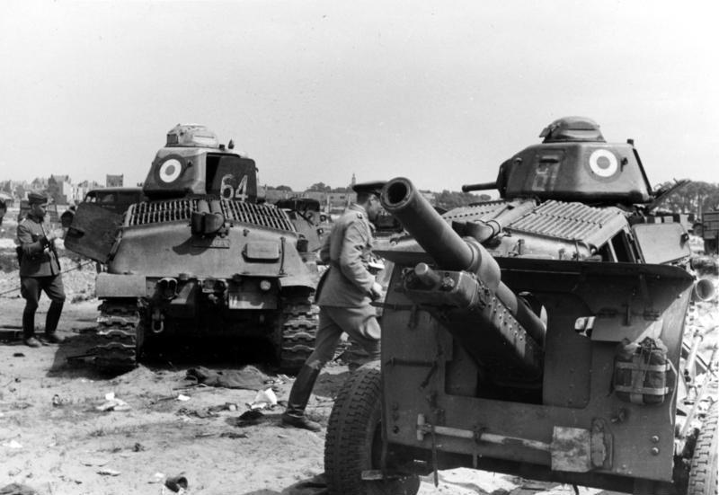
The Phony War
8 months→ Nothing “The Phony War” → British are still attempting to convince Hitler to attack the USSR.

Slide 9
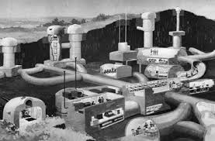
Maginot Line
After WWI, France builds an amazing series of fortifications along the French-German border.
Impregnable.
French and British are content to occupy the Maginot Lines and wait for the German attack.

Slide 10
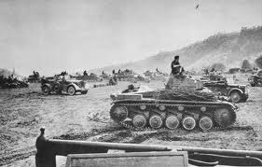
Battle of France
Germany sweeps through Belgium, encircles the better part of the French army and destroys them.
British army barely manages to flee the continent at Dunkirk.
French are compelled to surrender → Fascist government installed in France.

Slide 11
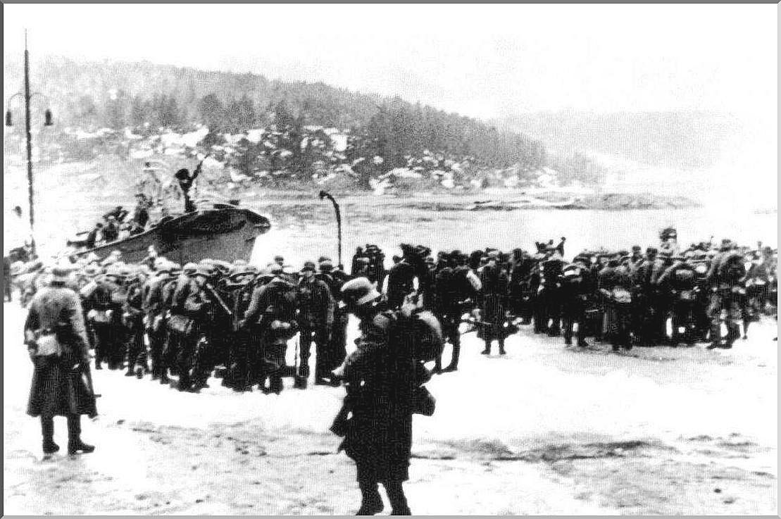
Consolidation
Germans consolidate their control over Europe, grabbing territory in Greece, Norway, etc. Bombing campaign is started against Britain.

Slide 12
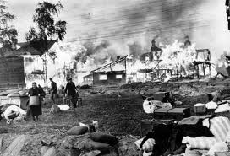
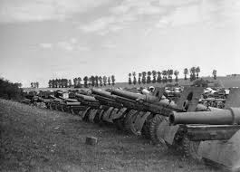
Operation Barbarossa
Germans prepare Operation Barbarossa→ Invade the USSR on June 22, 1941.
Red Army is unprepared!
The Great Purges
Stalin was expecting that they would have until the late 1940s until war breaks out.

Slide 13
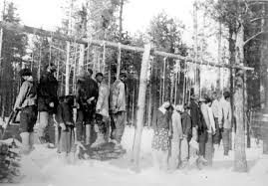
Blitz on the USSR
German troops immediately push the Soviets back, grabbing huge amounts of territory and inflicting heavy causalities.
Germans expect to be able to win in six weeks.
Soviet resistance, despite it all, remains surprisingly tough.

Slide 14
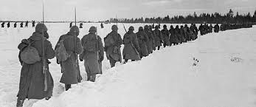
Winter
The Soviets are able to slow down the Germans enough that their invasions are unable to siege the capital.
Winter is very hard on the Germans and gives the Soviets time to redeploy and rebuild.

Slide 15
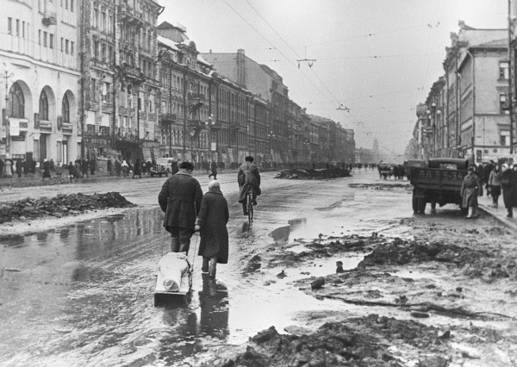
Siege of Leningrad
872 day siege of Leningrad.
Soviets manage to hold the city against sustained German assault.
Rumors of cannibalism in the city.
Only way to resupply the city is across the frozen lake.

Slide 16
Battle of Moscow
German troops get as far as the outskirts of the city.
Advance troops can see the spires of the Kremlin.
Desperate Soviet counterattack drives the Germans away.

Slide 17
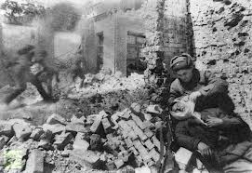
Battle of Stalingrad
Turning point of the war against the Germans.
5.5 month battle in the city.
Horrific street-fighting.
Germans are ultimately encircled and the 6th army group is compelled to surrender.
Germans never regain the initiative.

Slide 18
Battle of Kursk
Largest tank battle in the history of the world.
Germans attempt one last time to break through, but the Soviets beat them back.
Soviets begin a general offensive that will last until the end of the war.

Slide 19
Greater East-Asian Co-Prosperity Sphere
Japanese thoughts on the war: Must take this opportunity to drive Europeans out of Asia.
Greater East-Asia Co-Prosperity Sphere → Asia for Asians

Slide 20
War?
British, French, and Dutch colonies in Asia → Easy pickings.
American colonies → ??? Philippines, Guam, etc.
If the Japanese take the European colonies, will America get involved??? Who knows?
Decision is made: Attack the USA as well, rather than risk the Americans being able to prepare.

Slide 21
War!
Hammerstrike → Pearl Harbor, Philippines, Manilla, etc. All at once.
Japanese attack is ferocious and devastating. Capture all of the colonies the Europeans have.
American forces on the Philippines are defeated and forced to surrender.

Slide 22
Pearl Harbor and Guam
Pearl Harbor → US Carriers are absent. Allows for the possibility to continue the war. (3 years to build a carrier!)
Guam → US, incredibly, manages to win by destroying three of Japan’s four aircraft carriers in ten minutes. Japan’s offensives in the Eastern Pacific are over.
US forces rebuild and begin the Leapfrog Campaign across the Pacific Ocean.

Slide 23
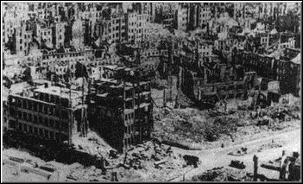
By 1943, Germany and Japan are in full retreat.
Firebombing of Dresden and Tokyo!!
Allied armies land in Italy and begin to advance up the peninsula. Eventually become bogged down by Italian and German forces.

Slide 24
Firebombing of Dresden
“Even at eight thousand feet, it was hot work for the RAF bomber crews. Thousand-degree heat scorched the bellies of the planes, and smoke rose to fifteen thousand feet, making the aviators wet with perspiration. The intensity of the firestorm below created superhot tornadoes, mile-high vortexes ripping oxygen from the air to feed their roaring, thermal engines. The torquing effect on the atmosphere hurled people, animals, and furniture skyward, up from a city that was falling down underneath them.”

Slide 25
Vonnegut on Dresden
“The Dresden atrocity, tremendously expensive and meticulously planned, was so meaningless, finally, that only one person on the entire planet got any benefit from it. I am that person. I wrote this book, which earned a lot of money for me and made my reputation, such as it is. One way or another, I got two or three dollars for every person killed. Some business I'm in.” --Vonnegut

Slide 26
Invasion of Italy
American and British armies land in southern Italy.
March up the peninsula.
Italian armies collapse → Germans step in to defend Italy.
Germans eventually bog down the Allied armies in the mountains of Italy.
Second front in Italy fails.

Slide 27
Normandy
Soviets are on a general offensive from 1943-1944. Demand the allies open up a second front to take some pressure off of the USSR.

Slide 28
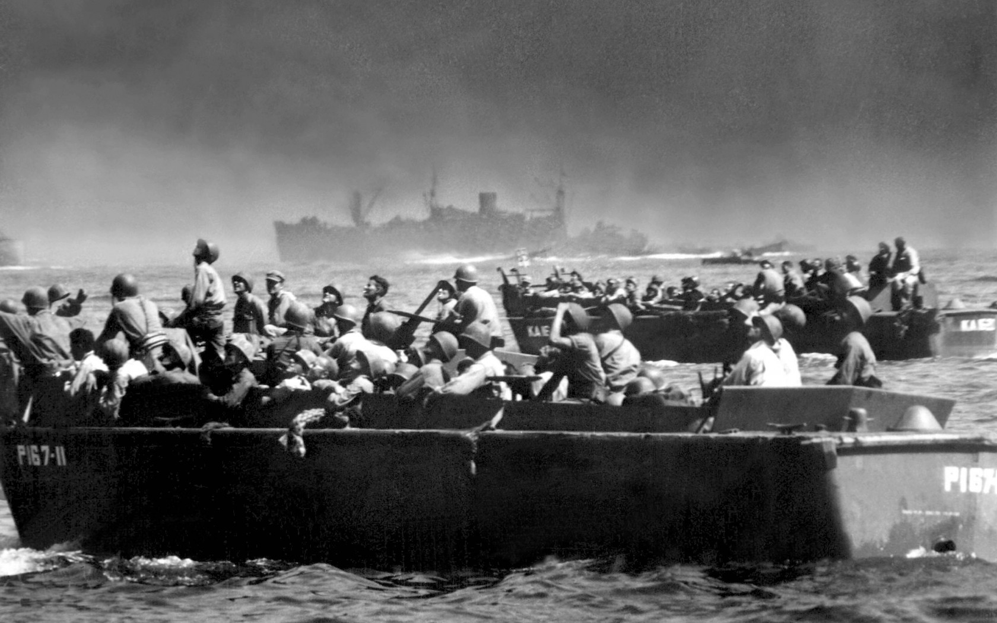
Normandy Landing
Normandy invasion → Allies occupy about 20% of Germany’s forces. Soviet occupy 80%.

Slide 29
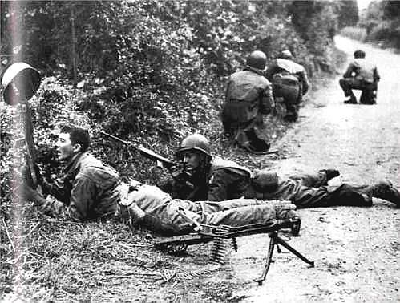
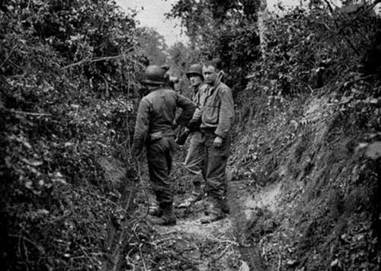
Battle of Normandy and France
Allied advance across France.
Slow and very conservative attack.
Delays the fighting.
Many Western Generals are eager to fight, but held back by more conservative leadership.
Patton
DeGaulle

Slide 30
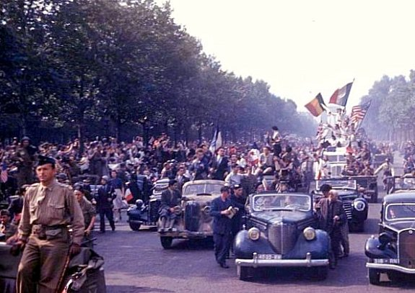
Liberation of France
In spite of slow advance, offensive is successful.
Germans are driven out of France.

Slide 31
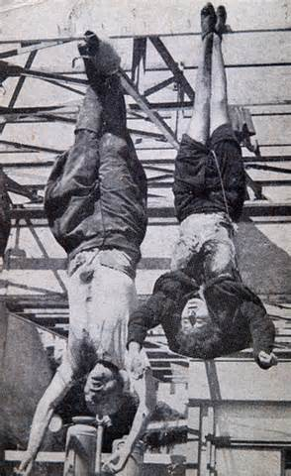
Fall of Italy
Italian partisans will topple Mussolini’s government in 1944.
Eventually partisans capture and execute Mussolini.

Slide 32
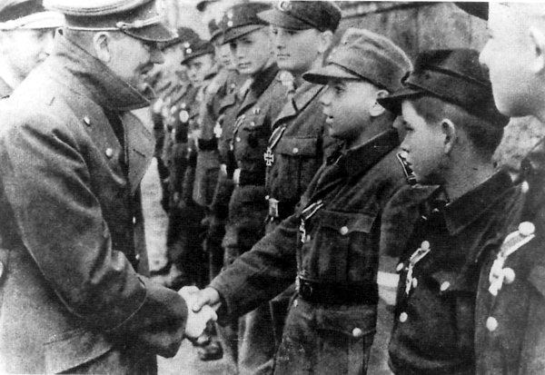
Soviet advance
In spite of the somewhat anemic Western response, Soviet advance continues.
Soviets draw in on Berlin and attack.

Slide 33
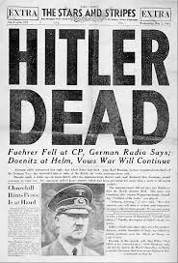
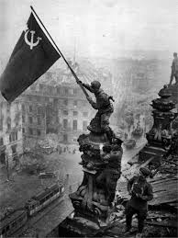
End of the war in Europe
Soviets eventually capture Berlin → Hitler commits suicide

Slide 34
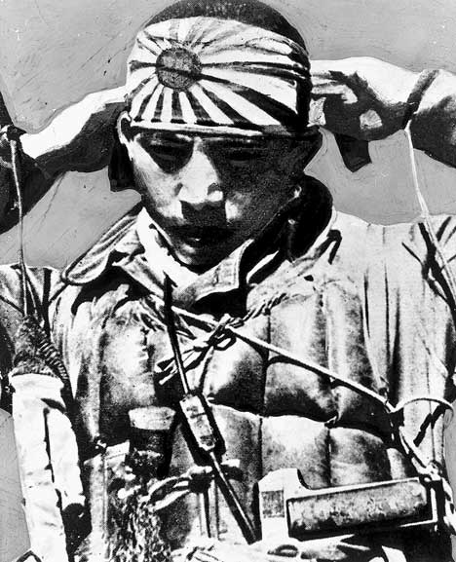
Japan 1944-1945
The Japanese government know that the end is in sight.
Some members of the High Command want to fight to the end.
Kamikaze Pilots are conscripted by the thousands.
Begin making thousands of bamboo spears to arm women and children to defend Japan.

Slide 35
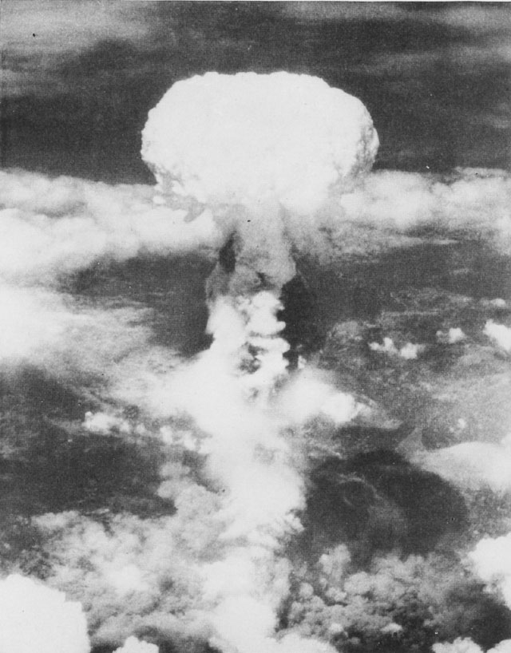
End of the war.
Others prevail and begin to ask for peace terms with the United States.
Truman apparently ignores this.

