Slide 1
LEARNING GOALS:
Overview of safety rules!
Science is an ongoing process that is a self correcting way of learning.
Following directions and using equipment properly promotes a safe and accident free lab environment. Proper tools and precise measurement equals accurate quantitative data.
08 -31- 11
WARM-UP:
1) In the cleaning pennies lab, which solution “cleaned” the best?
✪ 2) What is one thing we could change in the “cleaning pennies” experiment?
Agenda
Warm-Up (5 min)
Measurement WS (20 min)
Biomolecules Notes (30 mins)
Ketchup
Vinegar
Type of solution, type of coin, temp. of solution etc.
HOMEWORK DUE:
Contracts & Binder

Slide 2
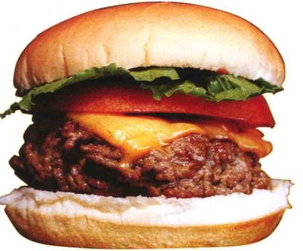
When you see the
Copy the notes!

Slide 3
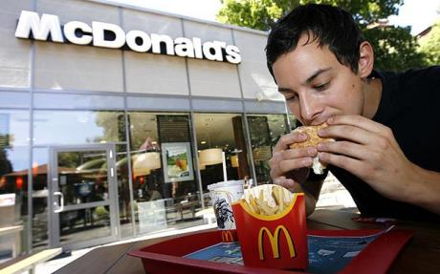
Nutrition:
Where do we get our nutrients?
Macromolecules, Vitamins and Minerals

Slide 4
Our body needs essential nutrients for growth, health and overall well being. We cannot be sedentary and deny our body these essentials and be healthy.
You need to be aware of the vital nutrients, vitamins and minerals available in everyday foods.

Slide 5
What are the four main types of macromolecules?
Carbohydrates
Lipids
Proteins
Nucleic Acids

Slide 6
Macromolecules Concept Map
Section 38-1
Nutrients
include
Carbohydrates
Fats
Proteins
Vitamins
Minerals
include
are made of
are made using
include
include
Simple
Complex
Amino acids
Calcium
Iron
such as
such as
Fatty Acids
Glycerol
Sugars
Starches
Fat-soluble
Water-soluble

Slide 7
Macromolecules
= Large organic molecules
Monomers (small molecules)
Polymers (large molecules)

Slide 8
Macromolecules
Carbohydrates (sugars & starch)
Lipids(fats)
Proteins
Nucleic Acids (DNA & RNA)

Slide 9
Carbohydrates
Monosaccharides (simple sugars)
i.e. C₆H₁₂O₆ - glucose
Disaccharides (double sugars)
i.e. sucrose – table sugar
Polysaccharides (complex sugars) starch, cellulose, and glycogen

Slide 10
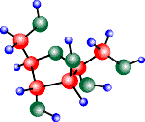
Carbohydrate Functions
Quick energy foods.
Storage:
Plants→ starch
Animals → glycogen

Slide 11
Lipids (FATS)
Molecules that store the most energy for living systems
Made of C, H, O
Insoluble in water

Slide 12
Types of Lipids
Triglyceride – 3 Fatty Acids bonded to a Glycerol
Steroids – cholesterol, hormones
Phospholipids
Unsaturated: Double bonds between some of the carbons
Saturated: No double bonds between the carbons

Slide 13
Lipid Functions
Important in cell membrane
High energy food
Protects vital organs
Insulates the body
Stores food for later use

Slide 14
Protein Function
Most Abundant-50% of Dry Wt
Essential to Life
Build structure
Movement: Makes up muscle tissue
(ex. actin and myosin).
Transport: Carries oxygen in an organism (ex. hemoglobin).
Immunity: Helps fight off foreign invaders (ex. antibodies).
Enzymes: Speed up chemical reactions
(ex. amylase and trypsin).

Slide 15
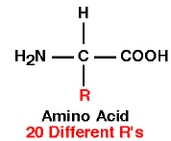
Protein (Structure)
H, O, N, C (sometimes S)
Monomer – amino acids
20 different
Each amino acid contains
an amino group (NH₂)
Carboxyl group (COOH)
Unique “R” group
Polymer: Polypeptide

Slide 16
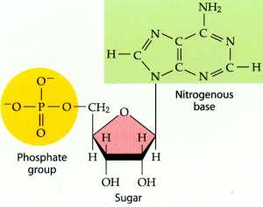
Nucleic Acids
Monomer - nucleotides (sugar, phosphate and nitrogen base)
DNA (Deoxyribonucleic acid)
RNA (Ribonucleic acid)

Slide 17
Carbohydrates
Main source of energy for the body
1gram = 4 Calories
Monosaccarides (Simple carbs) found in fruits, honey, and sugar cane
Polysaccarides (Complex carbs) found in starches such as grains & potatoes
Polysaccarides are digested into monosaccarides.

Slide 18
Fats
Fat is broken down into glycerol and fatty acids. 1 gram = 9 Calories
Essential fatty acids found in vegetable oils
Help body absorb certain vitamins
Used to produce
Cell membranes
Myelin sheaths
Hormones

Slide 19
Proteins
Supply raw materials for growth and repair
The building block of protein are amino acids.
1gram = 4 Calories
Enzymes
Regulatory & transport functions
Insulin
hemoglobin
Body only makes 12 AA
Must include the other 8 AA from your diet

Slide 20
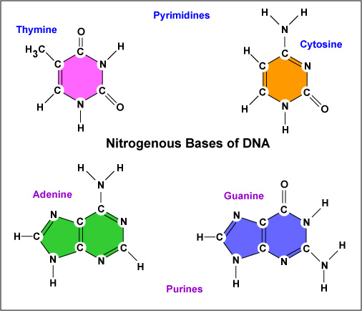
Nucleic Acids
Obtain nitrogen from protein sources.
Body makes and recycles the necessary components to produce nitrogenous bases that will form:
DNA & RNA

Slide 21
Vitamins
Organic molecules that help regulate body processes
Often work with enzymes
Most must be obtained from food
Vitamin deficiencies and overdose have serious consequences
There are 2 types of Vitamins:
Fat Soluble
Water Soluble

Slide 22
Types of Vitamins
Vitamin
A (retinol)
D (calciferol)
E (tocopherol)
K
B₁ (thiamine)
B₂ (riboflavin)
Sources
Yellow, orange, and dark green vegetables; dairy products
Fish oils, eggs; made by skin when exposed to sunlight; added to dairy products
Green leafy vegetables, seeds, vegetable oils
Green leafy vegetables; made by bacteria that live in human intestine
Whole grains, pork, legumes, milk
Dairy products, meats, vegetables, whole-grain cereal
Function
Important for growth of skin cells; important for night vision
Promotes bone growth; increases calcium and phosphorus absorption
Antioxidant; prevents cellular damage
Needed for normal blood clotting
Normal metabolism of carbohydrates
Normal growth; part of electron transport chain; energy metabolism

Slide 23
Types of Vitamins
Vitamin
Niacin
B₆ (pyridoxine)
Pantothenic acid
Folic acid
B₁₂ (cyanocobalamin)
Sources
Liver, milk, whole grains, nuts, meats, legumes
Whole grains, meats, vegetables
Meats, dairy, whole grains
Legumes, nuts, green leafy vegetables, oranges, broccoli, peas, fortified bread and cereal
Meats, eggs, dairy products, enriched cereals
Function
Important in energy metabolism
Important for amino acid metabolism
Needed for energy metabolism
Coenzyme involved in nucleic acid metabolism; prevents neural-tube defects in developing fetuses
Coenzyme in nucleic acid metabolism; maturation of red blood cells

Slide 24
Types of Vitamins
Vitamin
C (ascorbic acid)
Biotin
Choline
Sources
Citrus fruits, tomatoes, red or green peppers, broccoli, cabbage, strawberries
Legumes, vegetables, meat
Egg yolk, liver, grains, legumes
Function
Maintenance of cartilage and bone; antioxidant; improves iron absorption; important for healthy gums, tissue repair, and wound healing
Coenzyme in synthesis of fat; glycogen formation; amino acid metabolism
Required for phospholipids and neurotransmitters

Slide 25
Minerals
Inorganic nutrients
Needed in small amounts
By eating a variety of foods you can meet your daily requirements

Slide 26
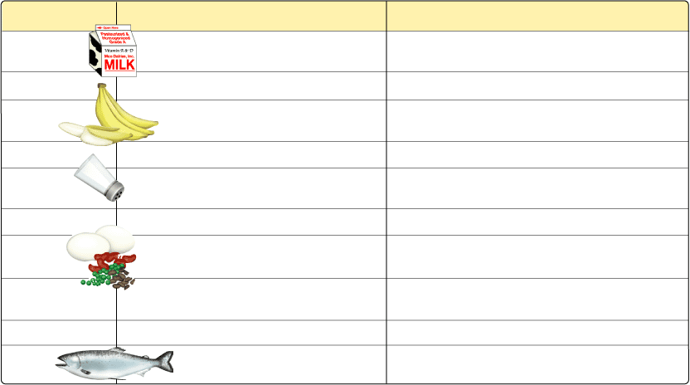
Types of Minerals
Mineral
Calcium
Phosphorus
Potassium
Chlorine
Sodium
Magnesium
Iron
Fluorine
Iodine
Zinc
Sources
Diary products; salmon; sardines; kale; tofu; collard greens; legumes
Dairy products; meats; poultry; grains
Meats; dairy products; many fruits and vegetables; grains
Table salt; processed foods
Table salt; processed foods
Whole grains; green leafy vegetables
Meats; eggs; legumes; whole grains; green leafy vegetables; dried fruit
Fluoridated drinking water; tea; seafood
Seafood; dairy products; iodized salt
Meats; seafood; grains
Function
Bone and tooth formation; blood clotting; nerve and muscle function
Bone and tooth formation; acid-base balance
Acid-base balance; body water balance; nerve function
Acid-base balance; formation of gastric juice
Acid-base balance; body water balance; nerve function
Activation of enzymes in protein synthesis
Component of hemoglobin and of electron carriers used in energy metabolism
Maintenance of tooth structure; maintenance of bone structure
Component of thyroid hormones
Component of certain digestive enzymes

Slide 27
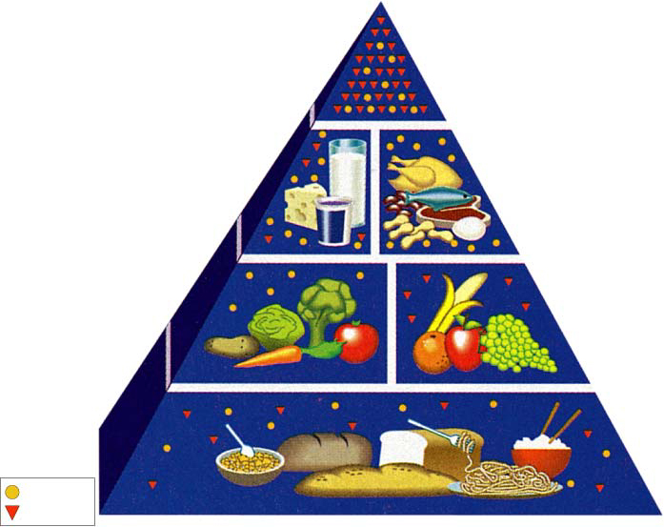
Food Guide Pyramid
Section 38-1
Fats, Oils, and Sweets (use sparingly)
Soft drinks, candy, ice cream, mayonnaise, and other foods in this group have relatively few valuable nutrients.
Milk, Yogurt, and Cheese Group
(2-3 Servings)
Milk and other dairy products are rich in proteins, carbohydrates, vitamins, and minerals.
Meat, Poultry, Fish, Dry Beans, Eggs, and Nut Group
(2-3 servings)
These foods are high in protein. They also supply vitamins and minerals.
Vegetable Group
(3-5 servings)
Vegetables are a low-fat source of carbohydrates, fiber, vitamins, and minerals.
Fruit Group
(2-4 servings)
Fruits are good sources of carbohydrates, fiber, vitamins and water.
Bread, Cereal, Rice and Pasta Group
(6-11 servings)
The foods at the base of the pyramid are rich in complex carbohydrates and also provide proteins, fiber, vitamins, and some minerals.
Fats
Sugars

Slide 28
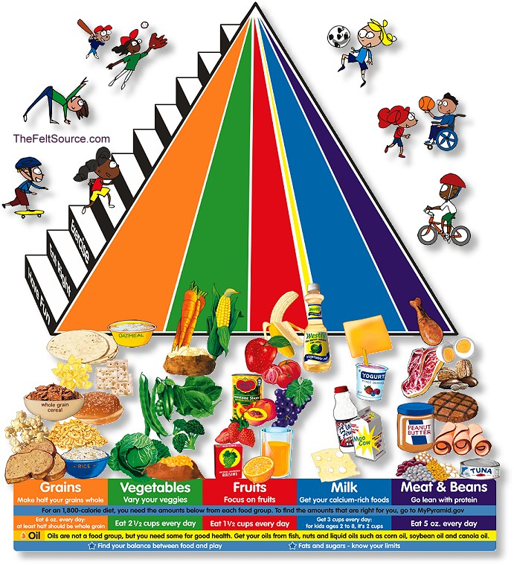

Slide 29
Food labels Activity
Work on numbers 14 and 15 on second page until the whole class is done with the first part of the worksheet. Then we will discuss numbers 10-13

Slide 30
Total fats
DORITO’s 8 grams
Klondike 1.5 grams
Trail mix 4 grams
Sour patch 0 grams

Slide 31
DUE TODAY:
Bimolecules Notes (KEEP)
“Every act of creation is first an act of destruction.” Pablo Picasso
DUE NEXT CLASS:
SAFETY CONTRACT & Syllabus contract
Binder/spiral/KLEENEX

