Slide 1
The regions of texas
Central Plains Region ~ Location, Landforms, Important Cities

Slide 2
Central plains region ~ Location
Part of the Great Central Plains of the US
Located in central portion of the state
Northern border is the Red River
Southern tip is the city of Austin
The Colorado River is the southwestern boundary
West border is the Cap Rock Escarpment
Page 30 of textbook ~ How else can you describe the location of this region
Notes:
ASK: What state borders the Central Plains? What other rivers flow through this region? Do the originate here or elsewhere? Review the terminology of plain (flat land)

Slide 3
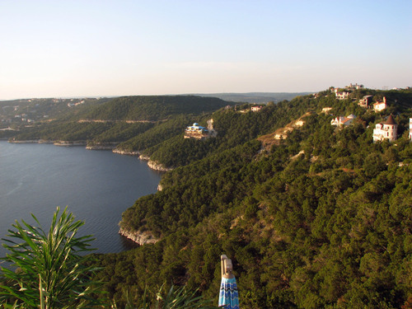
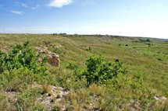
Central plains region ~ landforms
What are landforms?
Rivers
Colorado River
Brazos River
Red River
Lakes
Lake Travis is near Austin
Hills
Hill Country~just the Western edge
Plains

Slide 4
Central plains region ~ geographic features
Rolling grassy lands
Thick grasses
Cross Timbers area - large areas of hardwood trees
Limestone rock
Higher elevation because limestone doesn't wear down easily

Slide 5
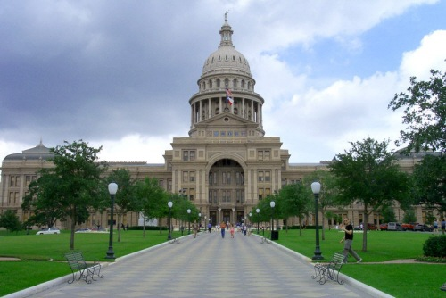
Central plains regions ~ important cities
Austin
Capitol of Texas
Located on edge of Central Plains and Gulf Coastal Plain Region
Hilly area
Lake Travis
On Colorado River
UT (major university)
State Capitol Building

Slide 6
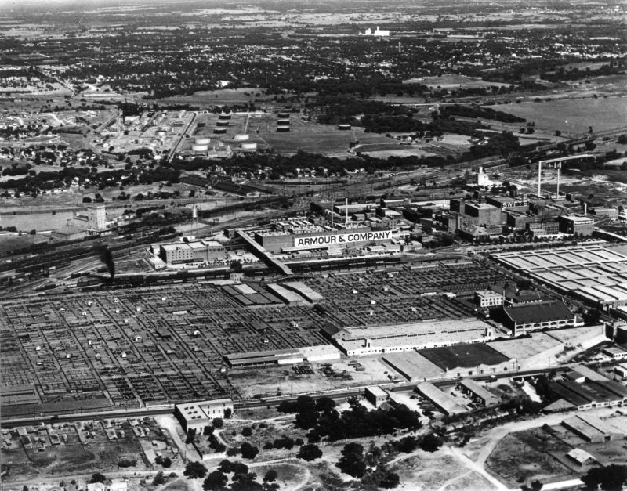
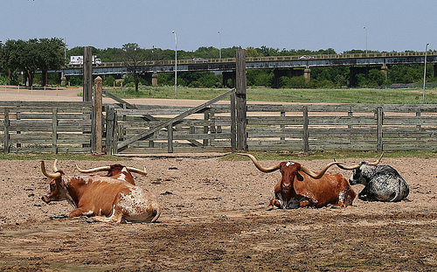
Central plains regions ~ important cities
Fort Worth
Famous for cattle industry in the past
Longhorns in Stockyards
Stockyards in 1940’s

Slide 7
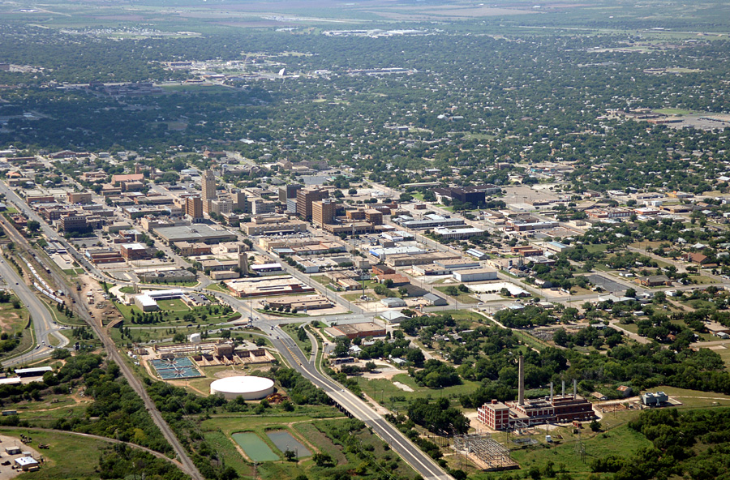
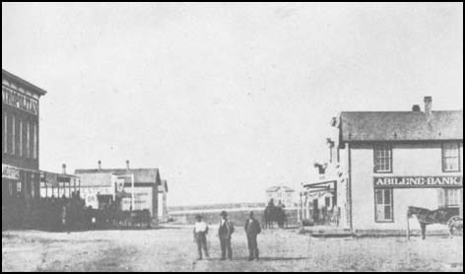
Central plains regions ~ important cities
Abilene
Two major colleges (ACU, Hardin-Simmons)
Major stop on cattle drives
1875
Abilene today

Slide 8
Central plains regions ~ important cities
Killeen
Fort Hood ~ Army base
Wichita Falls
Farming land
Cattle
Cotton industry
San Angelo
Hunting area
Farming land

Slide 9
End Day 1 stop here ☺

Slide 10
Regions of texas
Central Plains Region ~ Climate, Plants, Animals

Slide 11
Central plains region ~ Climate
Precipitation
20-30 inches per year
Dry air
Will not feel as hot as in the Coastal Plains even with same temperature
Cools off at night
Tornadoes
Weather conditions produce several tornadoes each year
Notes:
How does the precipitation compare to the Coastal Plains Region.

Slide 12
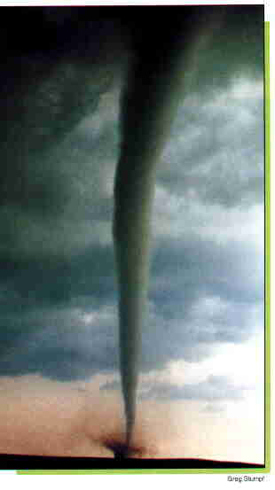
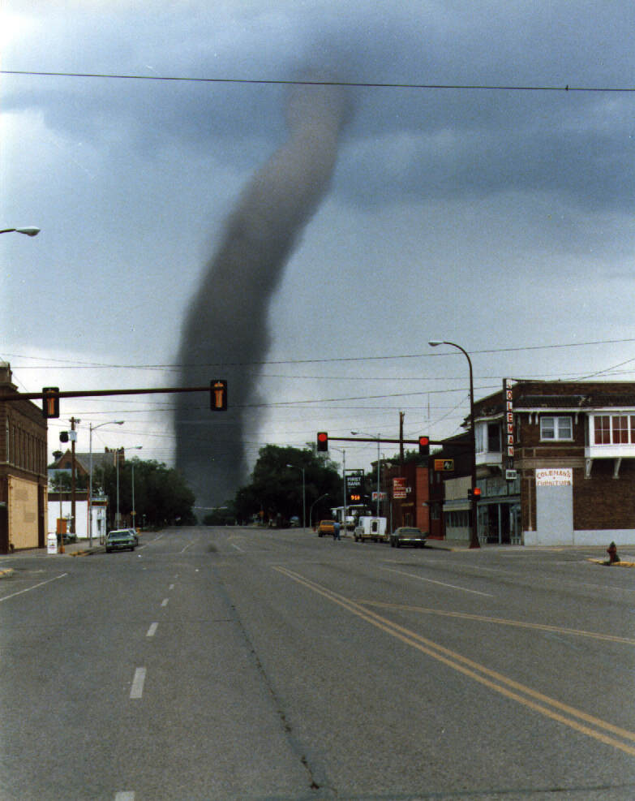
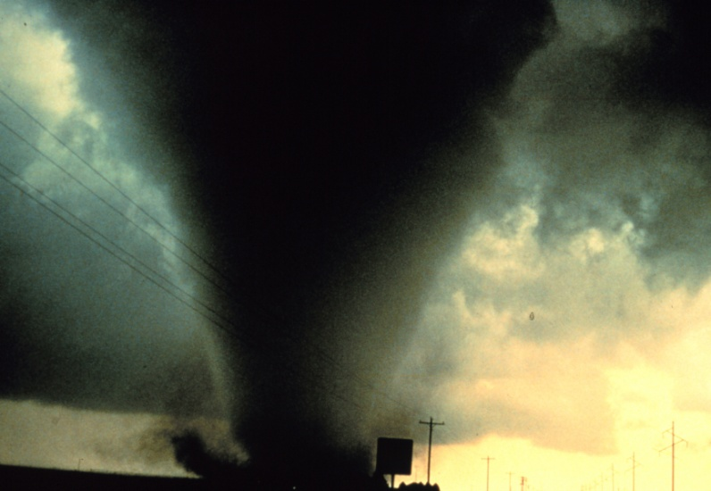
Central plains region ~ Climate
Tornadoes can be small or large. They can develop quickly. There is a lot of open land in the Central Plains, so the effects of the damage depends on whether the storm hit an open area or a heavily populated one.
Notes:
Note here the size difference of these tornadoes. Not always raining!!!

Slide 13
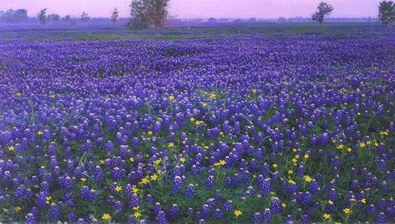
Central plains region ~ Plants
Cedar Trees
Used for making fence posts (important to farmers)
Tall grasses
Wildflowers
Many in the Hill Country

Slide 14
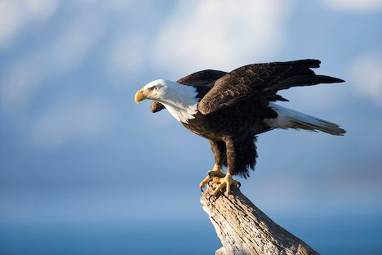
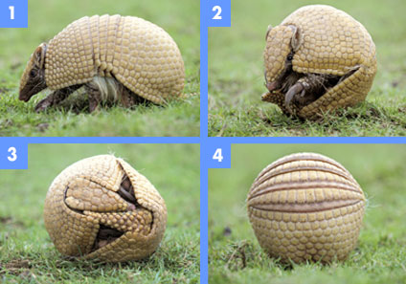
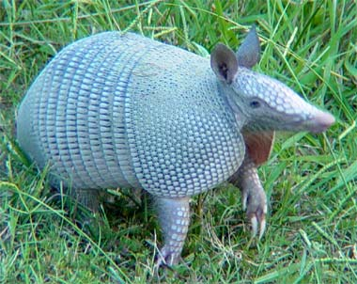
Central plains region ~ Animals
Bald Eagle
Armadillo
Defense from Predators
Notes:
Armadillos live all over the state, but are in abundance in this region.

Slide 15
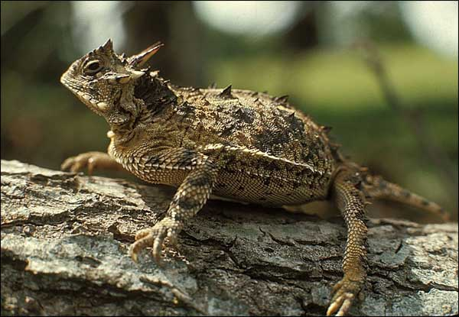
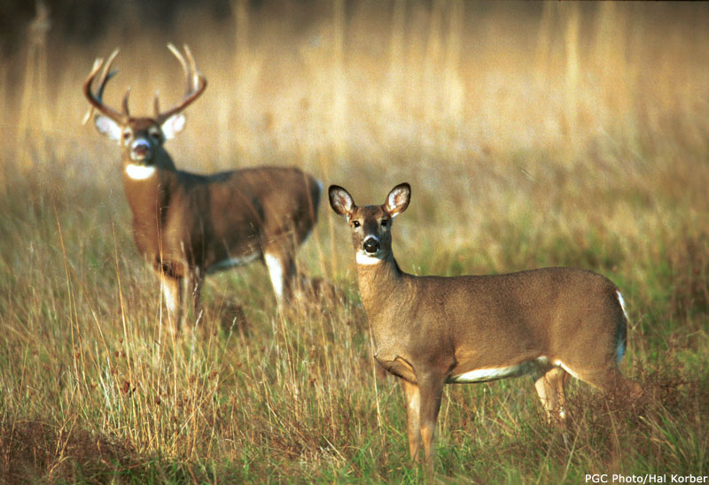
Central plains region ~ Animals
Horned Lizard
White-tailed Deer

Slide 16
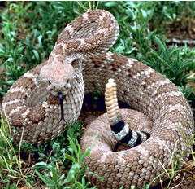
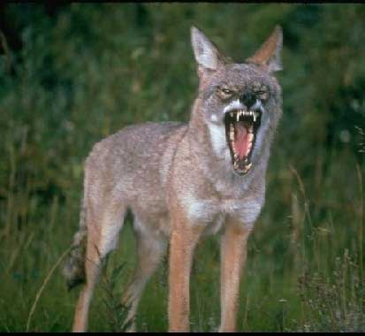
Central plains region ~ Animals
Rattlesnakes
Coyotes
Notes:
Coyotes and snakes live all over the state.

Slide 17
End of day 2 Stop here ☺

Slide 18
Regions of texas
Central Plains Region ~ Industry

Slide 19
Central plains region ~ Natural Resources
Limestone
Used for building
Minerals
Streams
Fertile lands for crops

Slide 20
Central plains region ~Industry
Farming
Fruits ~ Famous for peaches
Vegetables
Watermelons
Oats
Cotton
Ranching
Cattle
Angora goats (mohair)

Slide 21
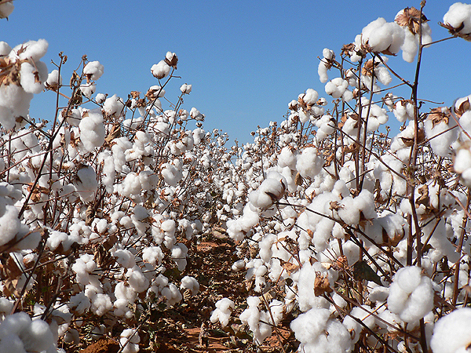
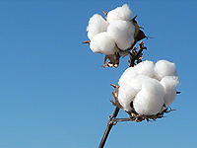
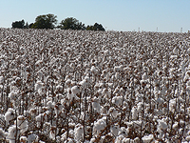
Cotton Industry

Slide 22
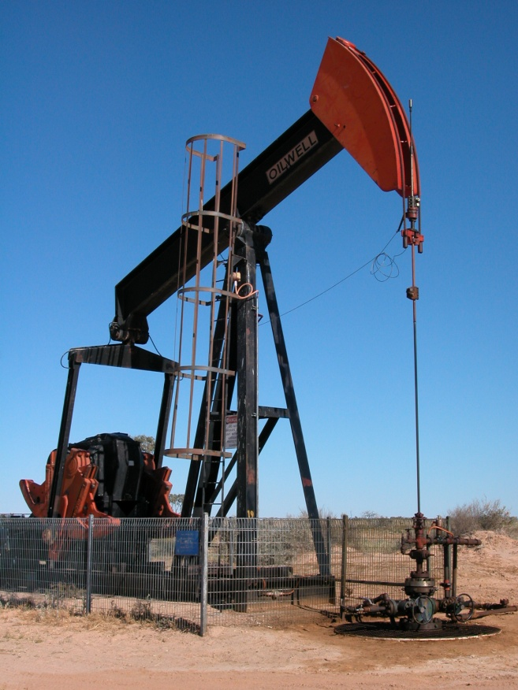
Central plains region ~Industry
Cedar Trees
Important for building fences
Used to build decks, closets
Oil
Natural Gas

Slide 23
Central plains region ~Industry
How does industry affect population?
Are there many large towns in West Texas?
What kinds of jobs do you think the industries in this region would provide?

Slide 24
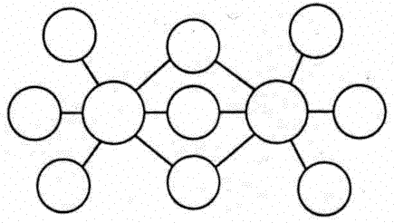
Central plains assessment
Create a double bubble map comparing the Coastal Plains Region with the Central Plains Region
Be sure to include the following:
Climate
Landforms
Plants
Animals
Industry

Slide 25
End of central plains region

