Slide 1
The Regions of Texas
Coastal Plain Region ~ Location and Important Cities

Slide 2
The Coastal Plain Region ~ Location
Located in the south and eastern part of the state
Part along the Gulf Coast is known as the Gulf Coastal Plain
Land starts at sea level and rises until it reaches the Balcones Escarpment.
Textbook page 30 ~ look at map
Notes:
Intro: Texas is so big that most of the countries’ natural features meet in this state. A natural region is an area made up of places that have the same physical features. The coastal plain is an area of low land that follows along the coast ~ the Gulf of Mexico for us.

Slide 3
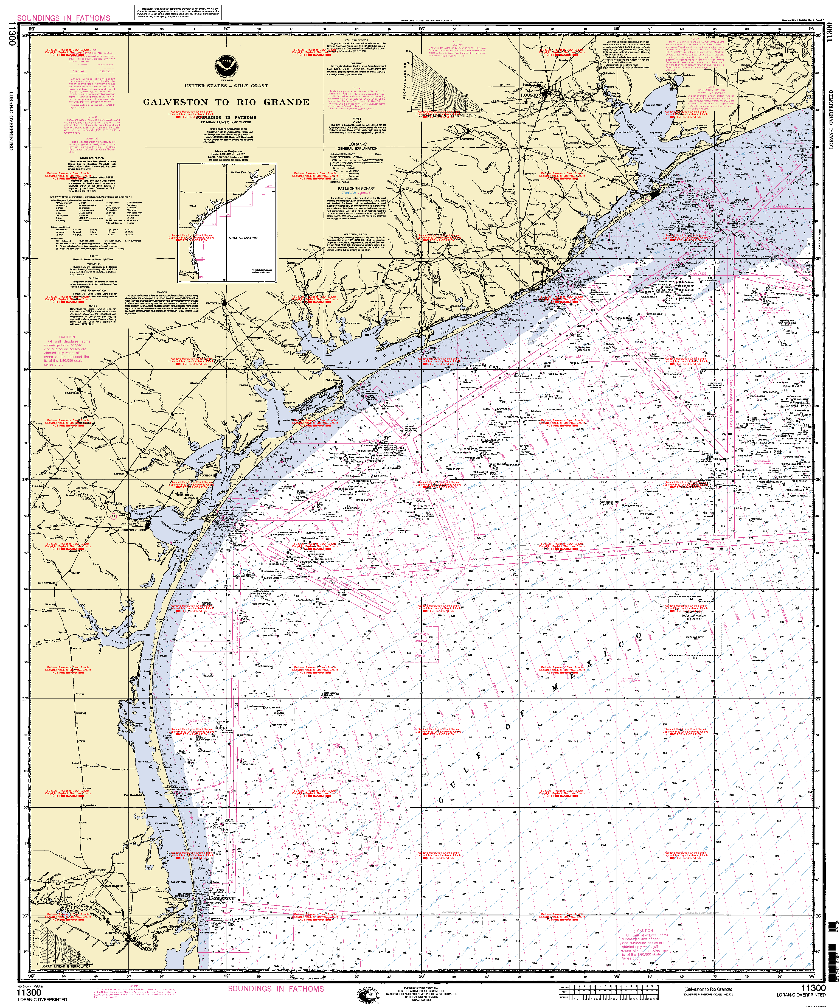
Notes:
Use this map to discuss the physical features of a coastline. They should notice all the rivers and creeks that empty into the Gulf. They should notice all the bay areas. Point out how low lying this land is.

Slide 4
Coastal Plain ~ Location
Rivers of Texas flow toward the Gulf of Mexico
What Texas rivers flow through this region?
Since the Gulf Coastal Plain is an area of low land, what problems do you think the people living here might encounter?
Flooding from too much rain or hurricanes
Floodplain is the low, flat land along a river
Bridges are built high and extends further than the usual width of the river
Notes:
Students continue to use map on pg. 30. Also see picture on page 31 to understand the large bridges that must be built over floodplains.

Slide 5
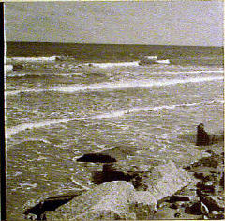
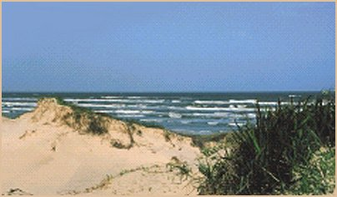
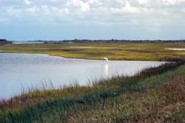
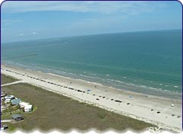
The Gulf Coastal Plain
Notes:
These are all pictures of the Gulf Coastal Plain. Do they all look the same? Some of the areas of sandy, some rocky, and some marshy. But they are all in the same region. Just because you live on the Gulf Coast, it does not mean your backyard will look like it does when you go to the beach. However, all the land is at or just above/below sea level. These areas are still prone to flooding because they are right on the coastline.

Slide 6
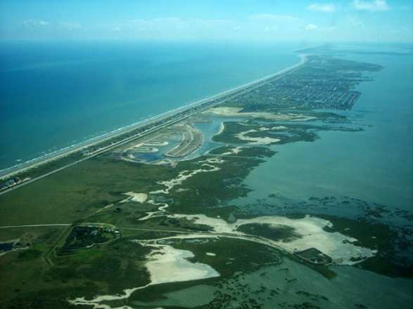

Slide 7
Coastal Plain ~ Location (cont.)
Part of coastal plain is actually not along the coast
Piney Woods of Texas is part of this region.
Where do you think it might be located? (map on pg. 30)

Slide 8
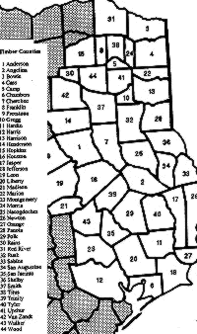
Piney Woods ~ Location
The pine forest lands or "Pineywoods" of East Texas extend from the Red River in the northeast corner of the state, southward to the region bordering Galveston Bay, and from the Louisiana border on the east to the Black Prairie region on the west. As shown in this map, this area includes all or portions of 44 Texas counties.
Notes:
Briefly explain where this is in relation to the map on pg. 30 in student book. The point is that this area is part of the coastal plain and encompasses a great area of land.

Slide 9
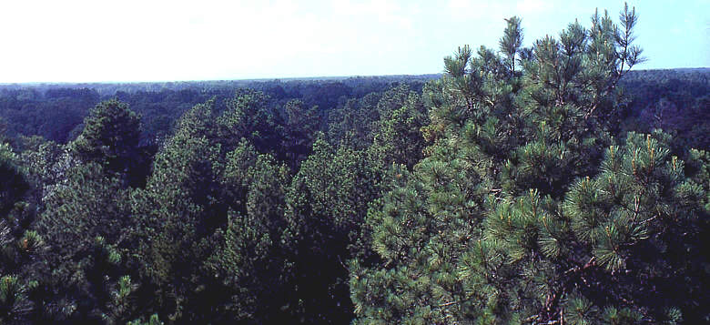
Coastal Plain Region ~ Piney Woods
The Pineywoods region encompasses the four National Forests in Texas: the Angelina, Davy Crockett, Sabine, and Sam Houston.
Notes:
Why do students think it might be called the Piney Woods? What is a national forest? Has anyone been camping in a national forest of Texas?

Slide 10
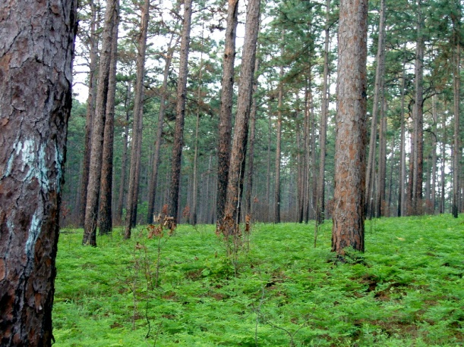
Piney woods

Slide 11
Gulf Coastal Plain ~ Important Cities
What cities do you see and recognize on map on page 30 along the coast?
What cities are in the Piney Woods part of the Coastal Plains?
Is the Dallas~Fort Worth area a part of this region? Do we live along the coast? Are we part of the Piney Woods?

Slide 12
Texas Chronicle Notebook
Color the Coastal Plain region of the Texas map given you green.
Cut out and glue onto right side of a new page of Texas Chronicle
Under the map, create a bubble map of the land features, important cities, and location we have discussed today.
Notes:
Model how to find the coastal region on the small maps, where to put in Texas Chronicle, and how to create the bubble map for today. We are only using the right side of the Texas Chronicle today (this is the input page)

Slide 13
The regions of texas
Coastal Plain Region ~ Climate, Plants, Animals

Slide 14
Taking Notes
Get Texas Chronicle
On new right-hand side, title page “Coastal Plain Region Climate, Plants, Animals”
Take notes as we go through lesson. You may choose to make a bulleted list under each heading. ☺
Coastal Plain Climate
Precipitation ~
Temperatures ~
Coastal Plain Plants
Notes:
Explain to students note-taking can be a bulleted list which will help them remember what we have learned. Help them set it up as you go through this lesson. The list should be on the right hand side (input) of the Texas Chronicle. We will write on the left hand side later in this lesson.

Slide 15
Coastal Plain Region ~ Climate
Textbook map pg. 30
How large an area is this region geographically? Use map scale and determine how many miles from north to south it covers.
In the southern part of the state (Brownsville and Corpus Christi areas) it is always pretty warm ~ even in the winter. This is a good place to grow fruit and vegetable crops because it rarely freezes.
Notes:
Give students a ruler and allow them to work with a partner to determine the size of this region.

Slide 16
Coastal plain region Climate (cont.)
What kind of climate do we have here in the DFW area?
Summer?
Winter?
How does it differ from the coastal area?
How does the climate of an area effect the people who live there?
Notes:
Allow time for students to turn and talk during first question. Then, they can share out with the two specific seasons mentioned on the slide.

Slide 17
Coastal plain region ~ climate (cont.)
Precipitation ~ see map on page 35
Does all of the Coastal Plain Region receive the same amount of precipitation?
With a learning partner, determine the range of precipitation in this region.
Why do you think there is more rain in the eastern half of the state than the western half?
What are the wild weather conditions that can occur in this region?
Notes:
Remind students that precipitation is water that falls to the Earth’s surface in the form of rain, sleet, snow, or hail. Precipitation range should be 24-48 or more inches per year. Tell students that the area along the border of Louisiana can receive as much as 60 inches per year. That is 5 feet of rain! Explain to students that the forest areas receive more rain and are more humid. The humidity is the moisture in the air which helps with the water cycle causing it to get more rain. Remind students what we learned about hurricanes along the coast and tornadoes in our part of Texas.

Slide 18
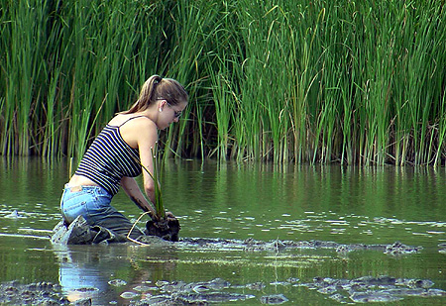
Coastal plain region ~ Plants and animals
Gulf Coastal Plain area
Full of wetlands and marshes. Some are freshwater and some are saltwater. A marsh is a wetland where a variety of tall grasses grow.
This is a flat land. Plants that grow need a lot of water and are able to survive warmer temperatures.
This woman is planting bulrushes in this marsh in order to spread population of this plant in Texas.
Notes:
ASK: Where does the salt water come from for the saltwater marshes? With the picture, have students notice how shallow the marshland is. This is not deep water. Plants root at the bottom and grow above the surface.

Slide 19
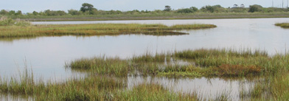
Coastal plain region ~ Plants and animals
This is a typical Texas marsh. Grasses were planted here to give wildlife a refuge (home).

Slide 20
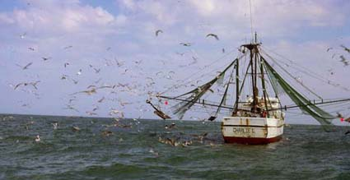
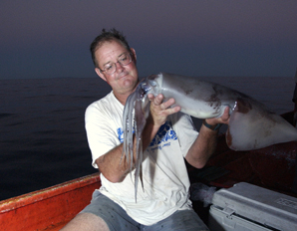
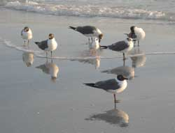
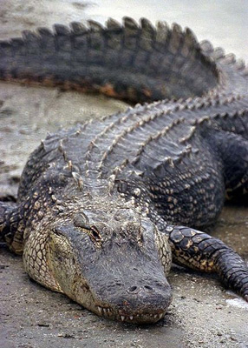
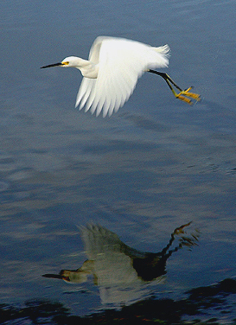
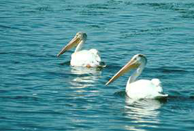
Gulf Coastal Animals
Birds eating left-overs from fishing boats
Many species of fish
Birds looking for food between waves in the sand
White Egret
Pelicans
Alligators
Notes:
Fishing is a huge industry along the coast. Many people vacation there just to go fishing. Shrimp boats bring large numbers of birds which can either float on the water to rest or have strong wings to get back to land. The white egret is a large bird that flies over the Gulf and marshes looking for food. Pelicans can be found along the seacoast and catch their prey (fish) directly out of the waves of the Gulf. Alligators are found mostly in the far eastern section of Texas along the rivers and marshes.

Slide 21
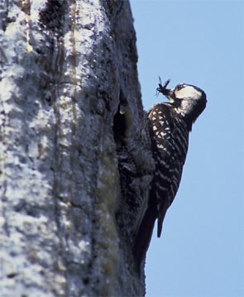
Coastal plain region ~ Plants and animals
Piney Woods area
The wooded areas bring other kinds of wildlife to Texas because they provide shelter in all types of weather and from predators
Red-cockaded woodpecker finds food inside tree holes or just under the bark. Doesn’t look like the woodpecker on the cartoons!

Slide 22
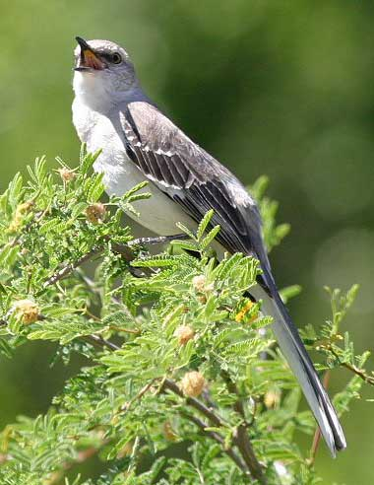
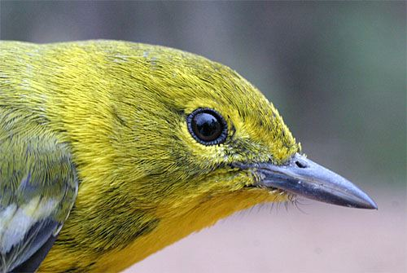
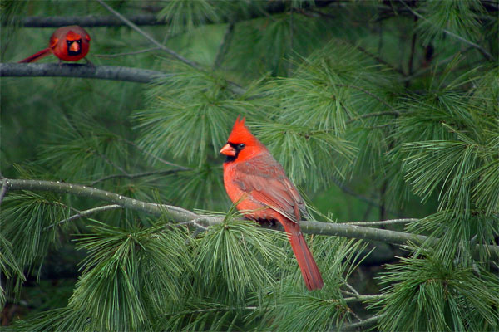
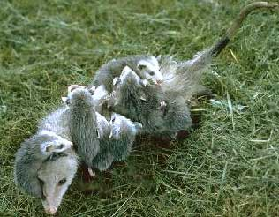
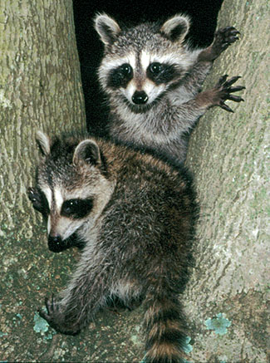
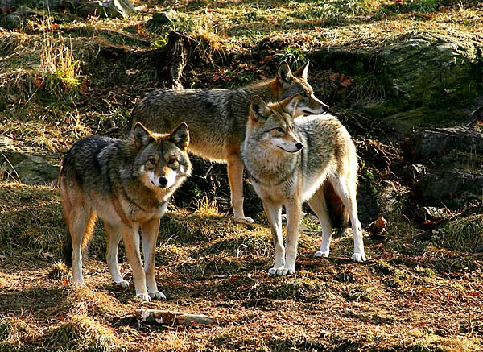
Piney Woods Animals
Warbler Pine
Mockingbird
Cardinals
Mother opossum carrying her babies
Coyotes
Raccoons
Notes:
Note: Coyotes are found all over Texas!!! We have them in our area a lot! There are many, many birds that live in the Forests.

Slide 23
Coastal Plain Region
On left side of Texas Chronicle, write a letter to a friend inviting them to visit the Coastal Plain Region of Texas.
Make it interesting, and mention why they would want to visit. Be specific about whether you are inviting them to the Gulf Coastal Region or the Piney Woods region of this area. What is the weather like, what animals would they see, etc.
Notes:
This is an optional assignment if you have time. I am NOT going to take a grade on it. The point of this assignment is for them to synthesize the information they have received today.

Slide 24
The regions of texas
Coastal Plain Region ~ Industry

Slide 25
Taking Notes
Get Texas Chronicle
On new page, take notes from today’s lesson on the right side of your page (the input page)
You will also need a textbook today.

Slide 26
Coastal Plain Region Industry
Industry ~ all the businesses that make one kind of product or provide one kind of service.
Goods ~ Products people buy and sell, such as food and clothing
Service ~ an activity that someone does for others for pay, such as cutting hair, repairing shoes, etc.
Cities have different types of goods and services. They may also have many types of industry.

Slide 27
Coastal Plains region industry
Textbook page 62.
What do you notice about this map key?
Turn and talk to partner about the industries for the coastal plains region of Texas.

Slide 28
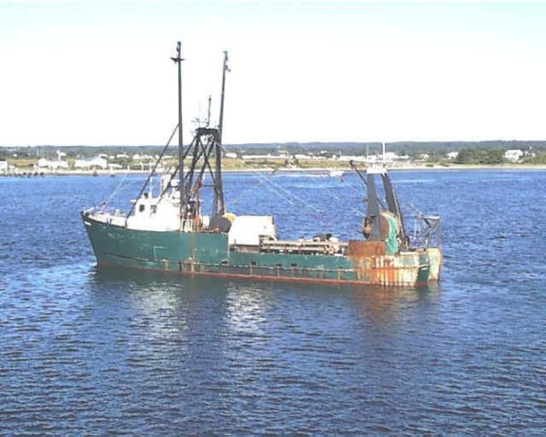
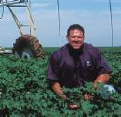
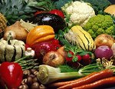
Coastal Plain Region ~ Industry
Gulf Coastal Region
Fishing
Oil
Fruits and Vegetables

Slide 29
Fishing Industry
Sea provides an almost endless supply of fish and shellfish. Fisherman must be careful not to over-fish one area.
Major place for shrimping industry
Fishing boats from Gulf of Mexico may stay out as long as 3 weeks and then return to port.

Slide 30
Oil Industry
Why do we need oil?
Off the Texas coast, there are large pockets under the ocean floor filled with oil.
Off-shore oil rigs pump the oil up from under the ocean floor.
Oil taken to refineries in the Houston area. Here the oil is made into gasoline and other products which need petroleum.

Slide 31
Agriculture Industry
The Valley’s climate provides the right temperature and precipitation for growing crops.
Fruits and vegetables can be grown year round.
The southern most area produces citrus crops such as oranges and grapefruit.
Areas just to north (but still in the Valley) produce many other fruits and vegetables.
Freezes rarely occur, but when they do our crop industry suffers.

Slide 32
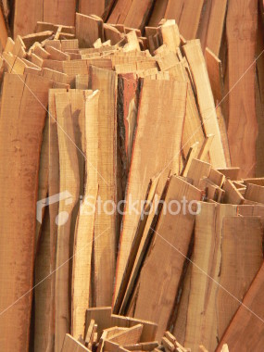
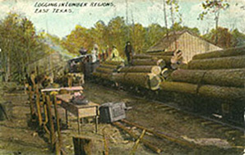
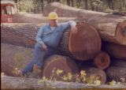
Coastal Plains Region Industry (cont.)
Piney Woods Area
Timber ~ What uses do we have for timber?
Notes:
Discuss the timber industry.

Slide 33
Population and industry
Population of an area is determined by the industry needs.
Many workers needed for the oil industry. The area around Houston is heavily populated for this reason.
The timber industry does not require quite as many workers, so the Eastern cities of Texas are not as large as the Houston area.
In the Valley, workers are needed to take care of and harvest crops. But these areas do not need large populations to do this work.
Other workers are also needed: doctors, nurses, teachers, city services, etc. These are true for all regions and generally are not included when discussing “industry.” However, Houston is well-known for its medical centers which requires larger than normal amounts of doctors, nurses, and other health related workers.

Slide 34
The regions of texas
Coastal Plains Region of Texas ~ Assessment

Slide 35
Directions for Assessment
You may use your Texas Chronicle Notebook
Make a tree map for the Coastal Plains Region.
Your headings should be as follows:
Place state of Texas here and color in the location of this region.
Coastal Plains Region of Texas
Location
Landforms
Climate
Plants
Animals
Industry
NOTE: The number of lines under each heading will vary according to what you have learned. Some may have more lines than others!

Slide 36
End of coastal plains region

