Slide 1
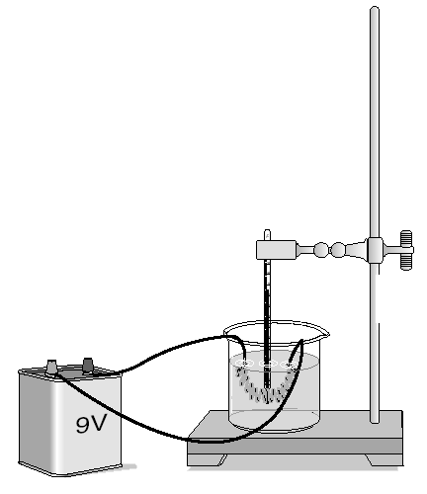
1.[SP03-11 #9] This experiment probably was set up to determine —
F how much mechanical energy the battery produces
G the pH of water during electrolysis
H the pressure created by an electric current
J how much energy is converted to heat
Notes:
J

Slide 2
2.[SP03-11 #43] Heat convection occurs in gases and liquids. Heat convection does not occur in solids because solids are unable to —
A absorb heat by vibrating
B transfer heat by fluid motion
C emit radiation by reflecting light
D exchange heat by direct contact
Notes:
B

Slide 3
3.[SP04-10 #33] A man who was sleeping wakes up because he hears the smoke alarm go off in his house. Before opening the bedroom door, the man feels the door to see whether it is warm. He is assuming that heat would be transferred through the door by —
F conduction
G convection
H radiation
J compression
Notes:
F

Slide 4
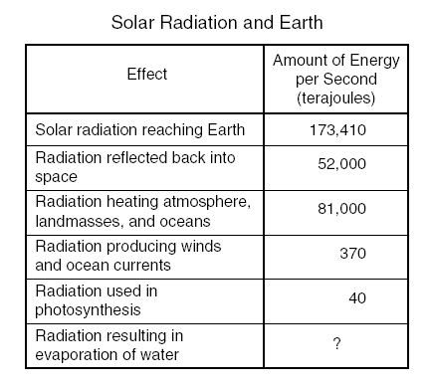
4.[SP04-11 #52] Assuming the chart contains all energy transformations in the Earth system, how much solar radiation goes toward evaporating water?
A 40,000 terajoules
B 92,410 terajoules
C 121,410 terajoules
D 133,410 terajoules
Notes:
A

Slide 5
5.[SP03-11 #50] A solar heater uses energy from the sun to heat water. The heater’s panel is painted black to —
F improve emission of infrared radiation
G reduce the heat loss by convection currents
H improve absorption of infrared radiation
J reduce the heater’s conducting properties
Notes:
H

Slide 6
6.[SP04-11 #42] In which container is the substance unable to transfer heat by convection?
Notes:
D

Slide 7
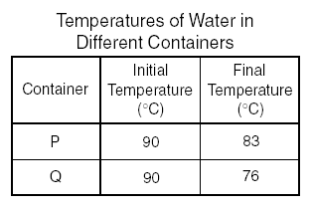
7.[JY04-11 #43] Container P and Container Q each were filled with 0.5 liter of water. The water was heated to 90°C. The table shows the temperatures after both containers were allowed to cool for 3 minutes. Compared to Container Q, Container P is a better —
F conductor
G absorber
H radiator
J insulator
Notes:
J

Slide 8
8.[SP03-10 #2] The primary way liquids and gases transmit heat is by the process of —
A reflection
B conduction
C radiation
D convection
Notes:
D

Slide 9
9.Molten rock rises in Earth’s mantle and then sinks back toward the core in a circular pattern, as shown in the diagram. This method of heat transfer is known as —
F conduction
G vibration
H radiation
J convection
Notes:
J

Slide 10
10. Heat energy is transferred from the hot end of a metal wire to the cool end through —
A radiation
B reflection
C conduction
D convection
Notes:
C

Slide 11
11. Heat cannot spread through a solid by convection because —
A a heated solid turns into a liquid
B atoms in a solid possess maximum kinetic energy
C heat is rapidly lost from solids through radiation
D particles of a solid are fixed in a rigid structure
Notes:
D

Slide 12
12. Mud at the bottom of a fishpond has a temperature of 15°C. After a week of colder air temperatures, the mud temperature drops to 12°C. Which of the following methods of heat transfer is most responsible for the change in the mud temperature?
A Water convection
B Air conduction
C Water reflection
D Ground radiation
Notes:
A

Slide 13
13. In winter the air just above the top bunk of a bunk bed is warmer than the air just above the bottom bunk because warm air rises. Which of the following describes the method of heating that causes this difference in temperature?
F Radiation from the room
G Heat transfer through the walls
H Convection currents in the room
J Heat conduction through the bed
Notes:
H

Slide 14
14. The transfer of heat by the movement of air currents in Earth’s atmosphere is an example of —
A conduction
B convection
C radiation
D fusion
Notes:
B

Slide 15
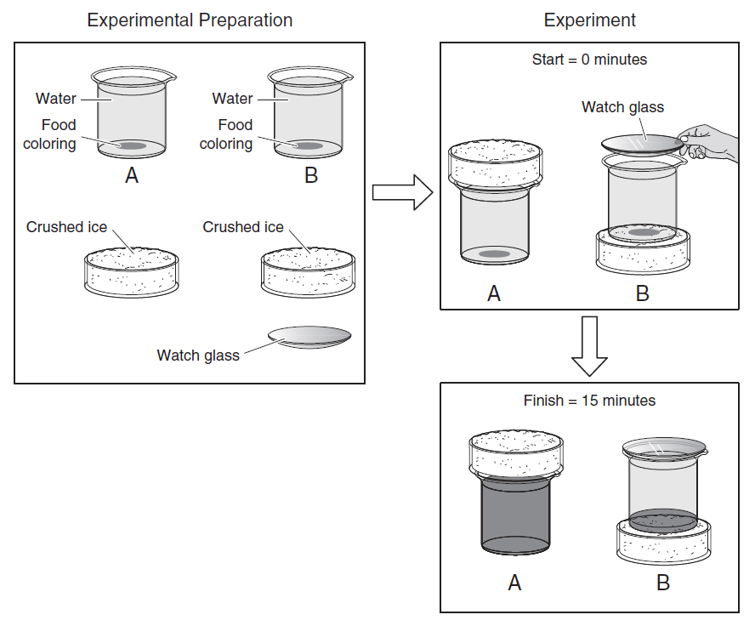
15. After 15 minutes the food coloring in Beaker A is evenly spread throughout the beaker, while Beaker B contains a thin layer of food coloring only at its bottom. These observations support the theory that convection currents in a fluid form more quickly if the fluid has —
A warmer layers at the bottom
B a covering on its surface
C reduced pressure on the bottom
D contact with a cooler surface
Notes:
A

Slide 16
Answer key:
1. J 2. B 3. F 4. A 5. H | 6. D 7. J 8. D 9. J 10. C | 11. D 12. A 13. H 14. B 15. A

