Slide 1

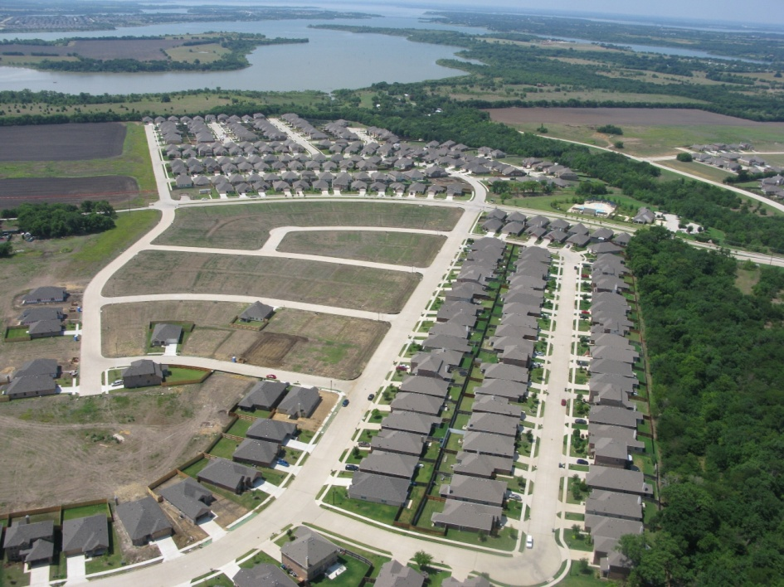


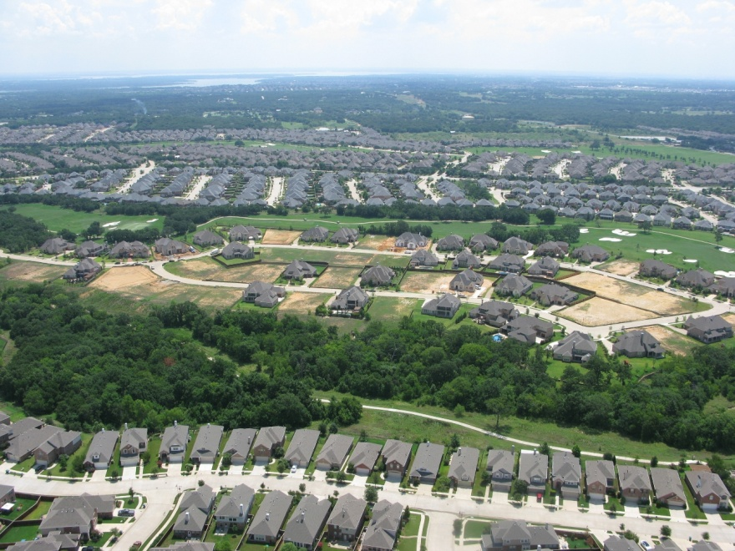
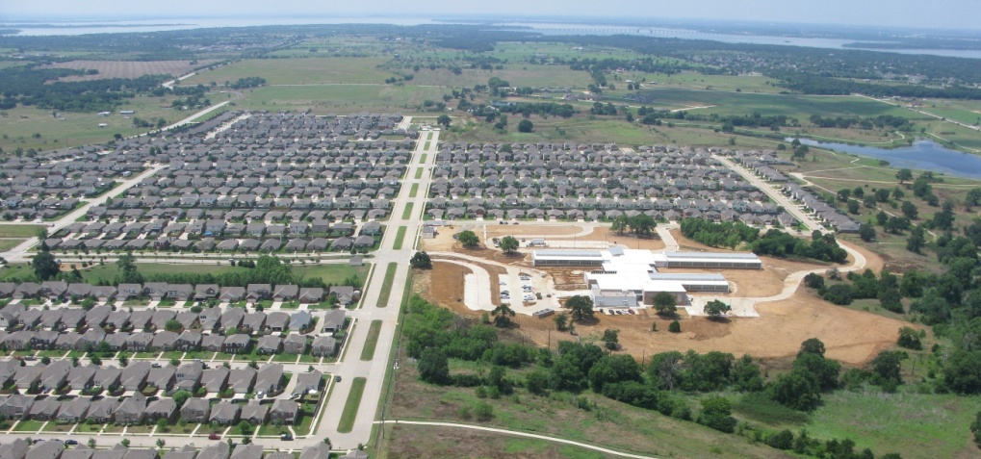

Denton Independent School District
Residential Growth Report
2nd Quarter 2010
August 10, 2010
Paloma Creek South
New Cross Oaks Elementary
Lantana - Bellaire

Slide 2
Dallas-Ft. Worth Housing Vital Signs
(3Q09 – 2Q10)
 | Dallas | Ft. Worth | DFW
Median New Home Price | $219,586 | $183,527 | $202,381
Annual Starts | 10,625 | 5,853 | 16,478
Annual Closings | 11,095 | 6,197 | 17,292
Finished Vacant Homes | 2,784 | 1,620 | 4,404
Month Supply | 3.0 | 3.1 | 3.1
Homes Under Construction | 2,855 | 1,421 | 4,276
Month Supply | 3.1 | 2.8 | 3.0
Vacant Developed Lots | 50,399 | 26,804 | 77,203
Month Supply | 56.9 | 55.0 | 56.2
Lots Under Development* | 2,261 | 978 | 3,239

Slide 3
Year-over-year growth
Annual Starts by Price Point
<$150K
2Q09: 2,770
2Q10: 2,781
Change +11
% Change +0.4%
$151-200K
2Q09: 3,804
2Q10: 5,366
Change +1562
% Change +41%
$201-300K
2Q09: 4,303
2Q10: 5,277
Change +974
% Change +22%
$301K+
2Q09: 3,009
2Q10: 3,104
Change +95
% Change +3.16%
Annual Starts of $151-200K Homes is on the rise
Year-over-year Change
Annual Starts: +18.67%, Annual Closings: -14.39%, Lot Deliveries: -84.8%
Starts, Closings & Lot Deliveries

Slide 4
Current DFW Market Conditions
Start and sales activity was elevated during the first quarter and first few weeks of 2Q10, however after the tax credit deadline, traffic and sales trailed off for many builders
Summer 2010 has provided mixed results for most homebuilders
Buyers are torn as interest rates remain at historic, attractive levels while the national economic conditions lack any substantial improvement; qualification standards remain conservative
Despite mixed results, overall housing conditions in DFW in terms of new home inventory and resale inventory remain healthy
Vacant lot supply is overall still above equilibrium. However, supply in the best submarkets/communities is approaching very tight levels
The credit crisis continues to limit access to the financing needed by developers, builders and home buyers
Small and regional builders are especially challenged in finding new replacement locations, as much of the desired supply is now spoken for, requiring the initiation of new lot development, which smaller builders are often unable or unwilling to do
Remainder of 2010 likely to be characterized by slower pace of home starts and sales as compared to Spring levels, however, employment gains should help to solidify 2011 market performance.

Slide 5
Annual Change Jun 09-Jun 10
TWC CES: +27,300
Dallas Fed: +11,800
Total DFW MSA: 2,892,800
+27,300
YEAR OVER YEAR
IN THE POSITIVE
Trough: 8/09 -137,400
Source: TWC – CES, Dallas Federal Reserve
Current TWC Growth Rate is +0.95%
DFW Current Employment Survey Current Trends Indicate Dallas Federal Reserve Accurate With Forecast of 1-2% Employment Growth for 2010 (+30-60K net new jobs)

Slide 6
DFW Unemployment Trends
Unemployment Rates – June ‘10
DFW: 8.5% Texas: 8.5%
US: 9.6%
UNEMPLOYMENT STILL HIGH
Not Seasonally Adjusted
Source: TWC - LAUS

Slide 7
 | Annual Change | % Change
Mining, Log, Const | (13,800) | -8.1%
Manufacturing | 5,500 | 2.1%
Trade, Transp, Util | (9,500) | -1.6%
Information | (6,900) | -8.3%
Financial Activities | (3,500) | -1.5%
Prof & Bus Services | 13,800 | 3.3%
Edu. & Hlth Serv. | 21,700 | 6.4%
Leisure & Hospital | (1,200) | -0.4%
Other Services | (1,300) | -1.2%
Government | 22,500 | 5.8%
SEASONAL LAYOFFS
(SUMMER JOBS)
DFW sees net creation of 72,500 jobs from Feb thru June, 2010
Source: TWC—CES Survey
Monthly Change in Employment
Notes:
7

Slide 8

Market Outlook
Economy
 | 2009 | 2010
1Q | 2,418 | 4,148
2Q | 3,201 | 4,460
3Q | 4,256
4Q | 3,613
New Home Industry
Note that 3Q09 was especially pronounced due to surge of homebuyers taking advantage of initial first time homebuyer tax credit
Current anecdotal reports regarding traffic and sales suggest that it may be difficult to better 2Q10 start pace. Thus it is possible that annual start rate could moderate slightly in 3Q10
But overall conditions continue to improve, just more slowly than desired
If annual start rate slows in 3Q10, expect it to pick back up in 4Q10

Slide 9

Denton ISD New Housing Activity
ACTIVITY FOLLOWS FED TAX CREDIT
Starts | 2003 | 2004 | 2005 | 2006 | 2007 | 2008 | 2009 | 2010 |  | Closings | 2003 | 2004 | 2005 | 2006 | 2007 | 2008 | 2009 | 2010
1Q | 404 | 609 | 479 | 674 | 447 | 350 | 141 | 251 |  | 1Q | 356 | 510 | 520 | 523 | 459 | 374 | 247 | 234
2Q | 648 | 805 | 639 | 644 | 468 | 441 | 189 | 248 |  | 2Q | 497 | 639 | 551 | 565 | 537 | 391 | 267 | 289
3Q | 572 | 782 | 712 | 542 | 486 | 311 | 314 |  |  | 3Q | 589 | 751 | 746 | 606 | 510 | 397 | 235
4Q | 680 | 387 | 512 | 451 | 301 | 205 | 212 |  |  | 4Q | 580 | 616 | 589 | 552 | 476 | 301 | 275
Total | 2,304 | 2,583 | 2,342 | 2,311 | 1,702 | 1,307 | 856 | 499 |  | Total | 2,022 | 2,516 | 2,406 | 2,246 | 1,982 | 1,463 | 1,024 | 523

Slide 10
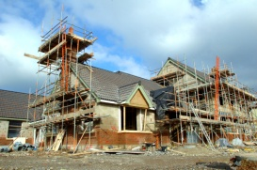
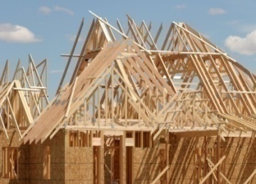
DFW School Districts by New Home Activity
Rank | ISD | 3Q09-2Q10 Starts
1 | Frisco | 1982
2 | Northwest | 1566
3 | Denton | 1026
4 | Keller | 902
5 | Mansfield | 732
6 | Eagle Mountain-Saginaw | 683
7 | Lewisville | 653
8 | Allen | 609
9 | Crowley | 522
10 | Wylie | 465
11 | Prosper | 443
12 | McKinney | 425
13 | Royse City | 324
14 | Burleson | 303
15 | Little Elm | 294
16 | Rockwall | 293
17 | Forney | 292
18 | Ft. Worth | 272
19 | Crandall | 258
20 | Dallas | 252
Denton ISD’s new home market produced 3rd most annual starts among Dallas-Ft. Worth school districts from 3Q09-2Q10

Slide 11

Activity by City Sector
Annual
Starts
Annual
Closings
Denton Co. East 373 380
Denton South 243 251
Denton North 165 144
Prosper 111 95
Lantana 106 129
Corinth 18 10
Shady Shores 7 10
Cross Roads 1 10

Slide 12
Top Performing Subdivisions
Starts
Annual
Closings
1-year
Forecast
2-year
Forecast
Paloma Creek 295 256 256
Lantana 129 79 64
Glenbrooke Est. 95 83 12
Savannah 72 33 33
Preserve at Pecan Creek 58 63 63
Longhorn Cove 53 0 0
Robson Ranch 46 53 53
Forest Meadow 42 23 23
12
Notes:
12

Slide 13
Price Range Analysis
HOMES AT $151-200K REPRESENT 50% OF THE ACTIVITY
STARTS AND CLOSINGS ARE LEVEL - CONTRACTORS ONLY BUILDING WHAT THEY CAN SELL
Annual Average Start Price $205,505
Annual Median Start Price $180,051
2Q10 Average Start Price $228,645

Slide 14
Lot Supply
Vacant Developed Lots 3,172 lots (37.1 months)
Approved Future Lots 4,436 lots (51.9 months)
Prelim. Planned Lots 39,463

Slide 15
Denton ISD Resale Market
(Single-Family Residential Only)
2nd Qtr typically has the highest sales;
2Q10 boosted by tax credits
Denton ISD Resale Data
SF Residential | 1Q08 | 2Q08 | 3Q08 | 4Q08 | 1Q09 | 2Q09 | 3Q09 | 4Q09 | 1Q10 | 2Q10
Total Sales | 414 | 580 | 573 | 346 | 357 | 507 | 529 | 482 | 321 | 670
Average Sales Price | $182,976 | $183,354 | $179,381 | $175,630 | $172,226 | $176,161 | $186,968 | $185,373 | $184,303 | $179,678
Days-on-market | 91 | 75 | 78 | 80 | 90 | 84 | 90 | 75 | 80 | 68
Foreclosure Forced Sales | 64 | 93 | 69 | 81 | 90 | 77 | 52 | 80 | 70 | 106
Pending Sales | 29 | 29 | 31 | 33 | 41 | 206 | 203 | 178 | 356 | 208
Active Listings | 119 | 139 | 202 | 281 | 318 | 727 | 984 | 885 | 989 | 1,148
Months Inventory |  |  |  | 1.8 | 2.1 | 4.9 | 6.7 | 5.5 | 6.3 | 6.9
Annual Total Sales |  |  |  | 1,913 | 1,856 | 1,783 | 1,766 | 1,924 | 1,894 | 2,002
 | % Change from previous qtr. |  |  | n/a | -3.0% | -3.9% | -1.0% | +9% | -1.5% | +5.7%
Annual Foreclosure Forced Sales |  |  |  | 307 | 333 | 317 | 292 | 299 | 281 | 308
 | % Change from previous qtr. |  |  | n/a | 8.5% | -4.8% | -7.9% | +2% | -6% | +9.6%
Active Listings |  |  |  | 281 | 318 | 727 | 984 | 885 | 989 | 1,148
 | % Change from previous qtr. |  |  | n/a | 13.2% | 128.6% | 35.4% | -10% | +11.8% | +16.1%
HIGHEST SINCE INFORMATION WAS TRACKED

Slide 16

New Cross Oaks Elementary
US-380 Corridor
Servicing Campuses
Cross Oaks Elementary
Navo Middle School
Denton & Ryan High School
16
Notes:
16

Slide 17
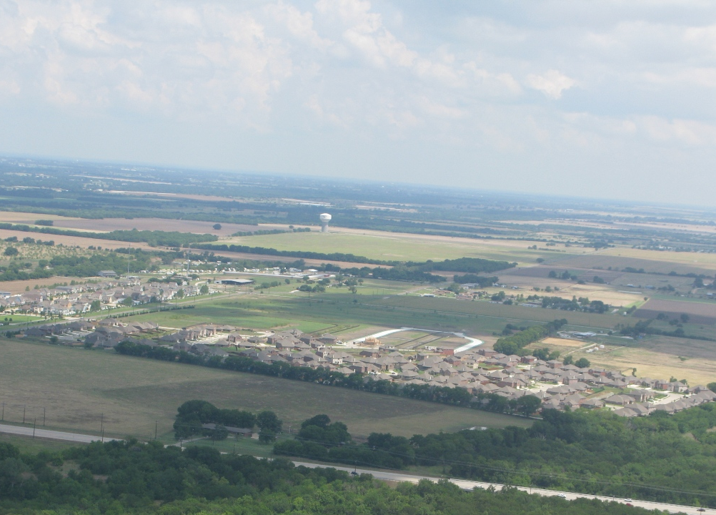
Glenbrooke Estates
US-380 Corridor
399 total lots
158 occupied homes
62 vacant lots
144 future lots planned
95 closings over past 12 months
46 new lots delivered in 2Q10
Servicing Campuses
Savannah Elementary
Navo Middle School
Denton High School

Slide 18

Paloma Creek South
US-380 Corridor
3,043 total lots
971 occupied homes
305 vacant lots
768 approved future lots
935 prelim lots planned
229 closings over last 12 months
Servicing Campuses
Paloma Creek Elementary
Navo Middle School
Denton High School

Slide 19

Lantana - Bellaire
Bartonville Area
62 total lots
30 occupied homes
26 vacant lots
6 homes U/C
Servicing Campuses
E.P. Rayzor Elementary
Harpool Middle School
Guyer High School
19
Notes:
19

Slide 20
Denton ISD – 2Q10 Summary
Starts up 21% vs. 2Q09 with 1,026 annual units (vs. 846)
  Activity boosted by expiration of federal tax credits on April 30th
Annual closings declined 15% to 1,033 units (vs. 1,212 in 2Q09)
  However, 289 closings in 2Q10 is most in 18 months (since 4Q08)
DISD ranks 3rd in annual new home starts among DFW school districts [Frisco (1st), Northwest (2nd)]
Homes under construction down 8% from 1Q10 (220 units currently u/c)
165 finished vacant units available
  Paloma Creek South (26), Glenbrooke Estates (22), Preserve at Pecan Creek (14), Longhorn Cove (13)
46 new lots delivered this quarter in Glenbrooke Estates (Prosper)
48,058 total potential lots remaining in the district
  3,172 vacant developed lots
  4,436 future lots
  39,463 preliminary lots planned
New home forecast for 3Q10-2Q11 = 923 starts
Highest quarterly resales total in over two years with 670 sales
2Q10 sees 106 foreclosure forced sales (70 in 1Q10)
Annual foreclosure rate down 2% vs. 2Q09 (308 vs. 317)
Copyright 2010 School District Strategies

Slide 21

Questions
21
Copyright 2010 School District Strategies

