Slide 1
Classical Civilization
Greeks, Persians, Guptas, Mauryans, The Han, The Qin, Romans

Slide 2
Classical Periodization
8000 BCE – 600 BCE = ANCIENT
600 BCE – 600 CE = CLASSICAL

Slide 3
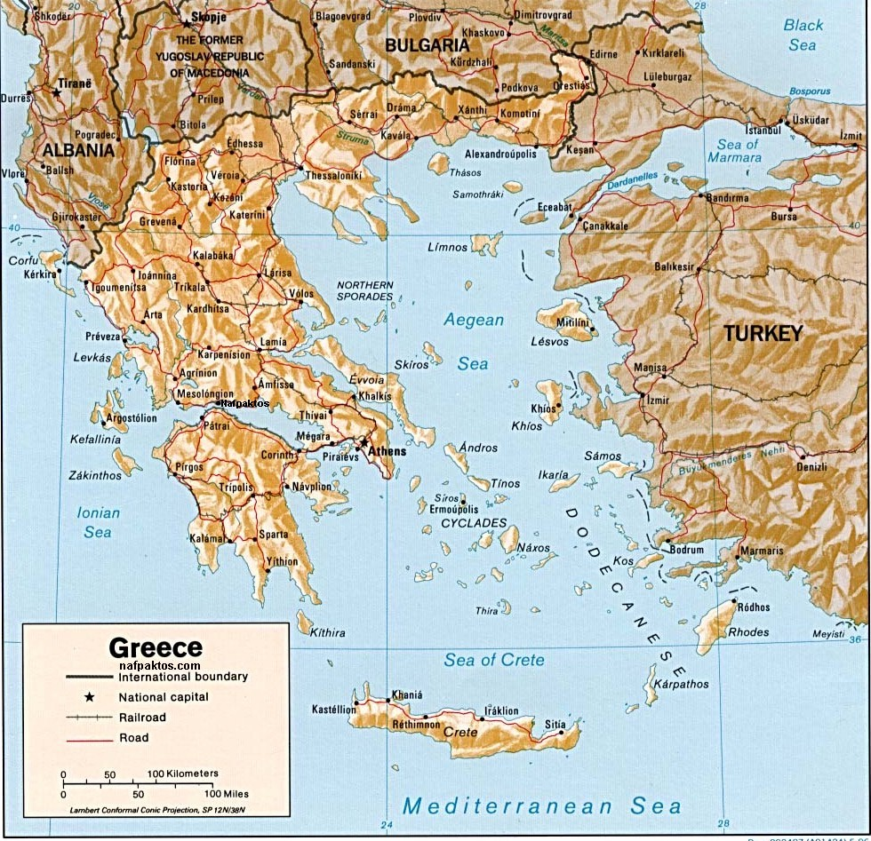
PHYSICAL MAP OF AREA

Slide 4
Ancient & Classical Greece
Ancient: 2000 BCE – 1100 BCE
Minoans
Mycenaeans
Classical Greeks will inherit language, gods, technology, trade routes, early political and social structure from their two predecessors.
Cosmopolitan Mediterranean at this time
Greek Dark Age: 1100 BCE – 800 BCE
Iliad/Odyssey composed by Homer in this period
Invasion of Troy
Phoenicians begin to reconnect Greece with the rest of the Mediterranean
Result: Greece trades again ~800 BCE
Result: Greeks borrow the Phoenician alphabet & make their own

Slide 5
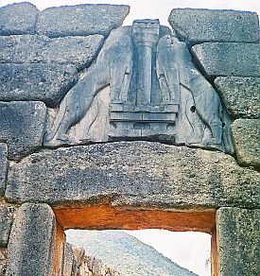
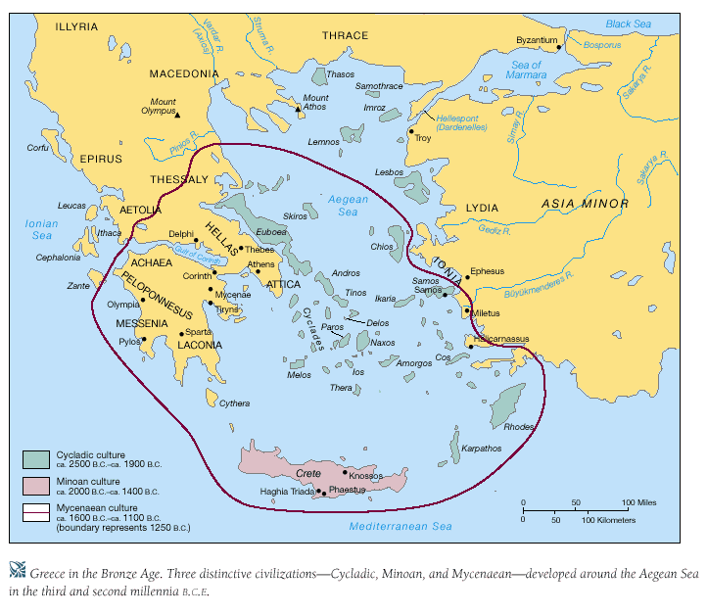
ANCIENT GREECE

Slide 6
Archaic Greece: 800-480 BCE
Oral tradition kept Greek culture alive
Imagine keeping the Odyssey or Iliad alive through memory and speech…disgusting, right?
Polis (pl. poleis) – city-state. Autonomous. Geography!
Colonization – Black Sea, Southern Italy, Sicily, Anatolia, Aegean Islands, North Africa, Southern France
Economically motivated
Took fire from hearth of home city to hearth @ colony
Greeks = Hellenes. Non-Greeks = Barbaroi
Councils of nobles = pol. dominant, owned lots o’ land
Peasants/debt slaves worked land
Small middle class of merchants, craftsmen
Religion – anthropomorphic gods. Athena, Zeus, etc.
Humanism – celebration of the individual
Greece slowly moving from monarchy/oligarchy to democracy

Slide 7
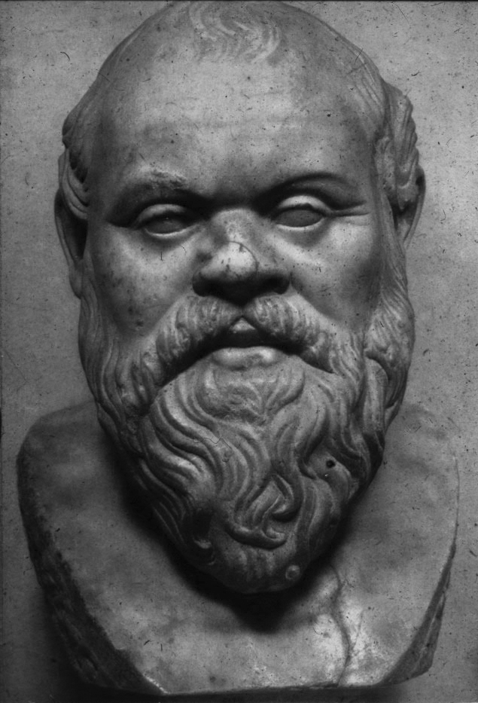
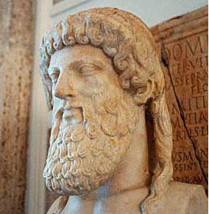
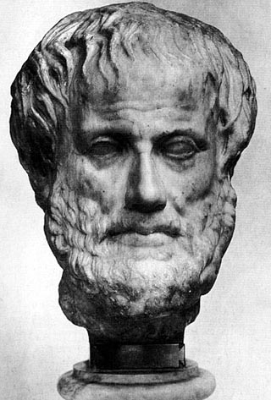
RATIONITY AND PHILOSOPHY
The formation of Greek cultural traditions
From the 8th century, drew inspirations from Mesopotamia and Egypt
About 800 B.C.E., adapted the Phoenicians' alphabet to their own language
The Greek cultural feature: a philosophy based on human reason, rationality
Socrates (470-399 B.C.E.)
Athenian philosopher, determined to understand humans
Encouraged reflection on ethics and morality
Integrity was more important than wealth and fame
"The unexamined life is not worth living"
Critical scrutiny to traditional ethical teachings
Condemned to death for corrupting Athenian youths
Plato (430-347 B.C.E.)
A zealous disciple of Socrates
The theory of Forms or Ideas
His Republic expressed the ideal of philosophical kings
Aristotle (384-322 B.C.E.)
Plato's disciple, but distrusted theory of Forms or Ideas
Devised rules of logic, scientific method, father of western science
His Nicomedian Ethics became later basis in Christianity
Legacy of Greek philosophy
Intellectual authorities for European philosophers until 17th century
Intellectual inspiration for Christian and Islamic theologians.
Provided a powerful intellectual framework for future generations

Slide 8
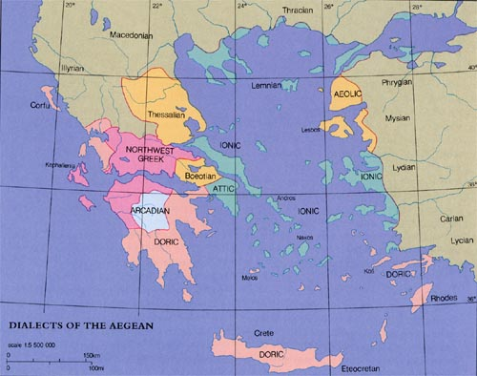
GREEK TRIBES

Slide 9
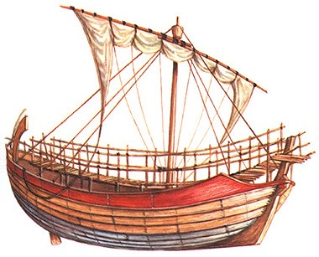
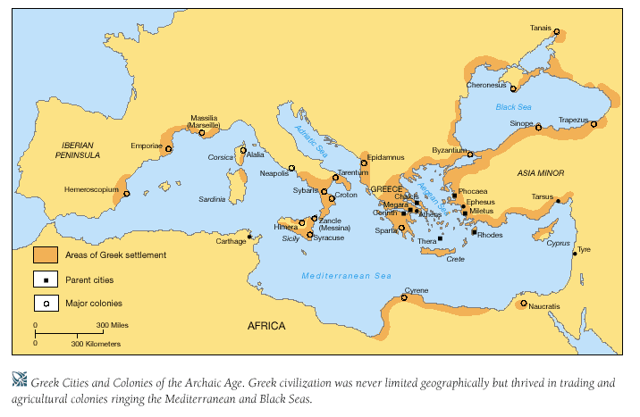
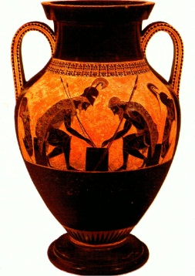
THE GREEK WORLD

Slide 10
Classical Greece: 480-323 BCE
Athens & Sparta = politically dominant poleis
Sparta:
professional army, people existed to support Sparta
Isolated mostly, few political alliances
Women: raise strong children, voices welcomed in public debate
Athens:
4 classes of people, classes 1-3 = participated politically, class 4 = no political participation. Really, only about 15% of people participated.
Classes separated by amount of wealth/land holdings
Pericles later will alter system to let lower classes hold office
Strong navy – secured trade routes, used to hold down Delian League members
Women: produce children, stay at home, no political rights
Hoplite – Greek footsoldier. Fought in phalanx.
Persia comes into the picture
Ionian Greek rebellion @ Mitelene. Persia squashes it.
Athens had supported Ionian Greeks. Persia goes after Athens.
Darius’ Invasion
The battle of Marathon, 490 B.C.E.
Greeks led by Spartans and Athens battled Persia to a draw
Xerxes Invasion
To fight Persians, Athenians build a wall of wood, or a navy
Xerxes seized, burned Athens
Athenian navy destroys Persian in the battle of Salamis, 480 B.C.E.
Persian army retreated back to Anatolia, 479 B.C.E.

Slide 11
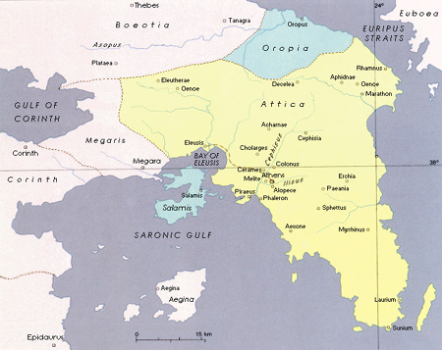
POLIS OF ATTICA

Slide 12
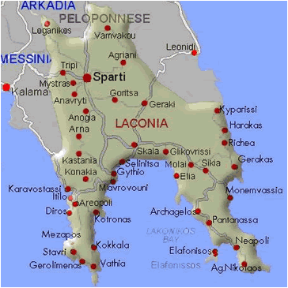
LACONIA: SPARTA

Slide 13
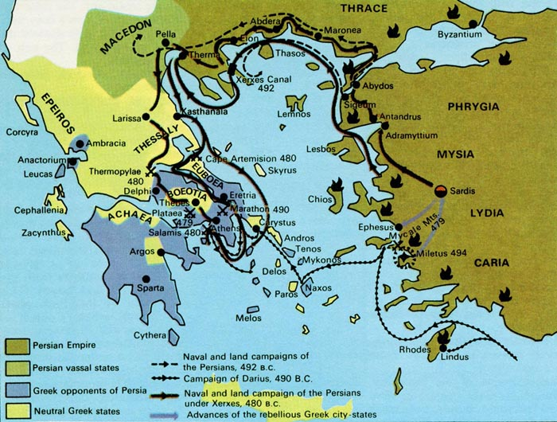
MAPPING THE PERSIAN WARS

Slide 14
Classical Greece (cont.)
Peloponnesian War (431 ~ 404 BCE): everyone hates Athens.
Athens = greedy, tyrannical towards Delian League.
Rebuilt by Pericles
Sparta, Delian League, money from Persia go to war w/Athens.
Fighting rampant, even goes as far west as Sicily.
Sparta wins, even w/lesser navy than Athens.
Plague in Athens helped, too.
Spartan rule was no better than Athenian rule.
Political unrest in Greece continued.
Spartan hegemony soon replaced by Theban hegemony.
Meanwhile, in Macedonia…
King Philip II (359-336 BCE) – great military leader/strategist
Father of Alexander the Great
Longer spears, cavalry, catapults
Defeats southern Greece, tries to launch attack vs. Persia
However, is assassinated before he can see it through.

Slide 15
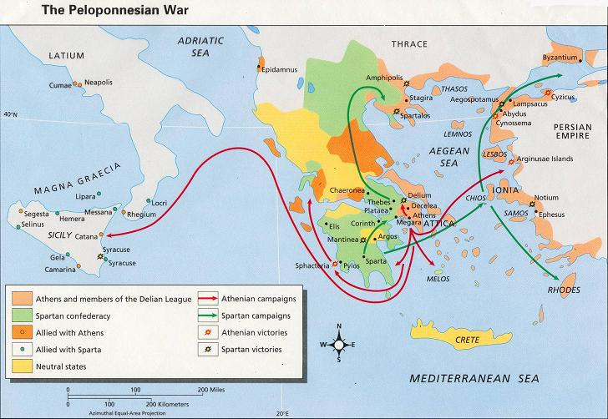
THE PELOPONNESIAN WAR

Slide 16
Hellenistic Greece: 323-30 BCE
Alexander the Great (356-323 BCE)
Avenges Persian attacks on Greece, conquers the known world.
Conquered an empire that expanded from Greece, to Egypt, the Levant, Anatolia, Mesopotamia, Persia, and even into India.
How do you manage a beast this big?
Put loyal Greek officials in charge of conquered poleis.
Later, this changed to Persian officials, much resented by Greek soldiers.
Saw himself as the rightful heir to the Persian throne
Began dressing in Persian clothing, adhering to Persian culture
Again, this is VERY unpopular with his Greek friends and fellow soldiers
Dies at the age of 32.
Other than the military conquests, why is he important?
Later kings, Caesars will develop an “Alexander complex”
Julius Caesar is known to have cried on his 32nd birthday because his achievements were nothing like Alexander’s.
Tomb/body of Alexander – relic site long ago, unknown whereabouts now.
Greek Hellenistic age ends after Rome finally subjugates Greece.

Slide 17
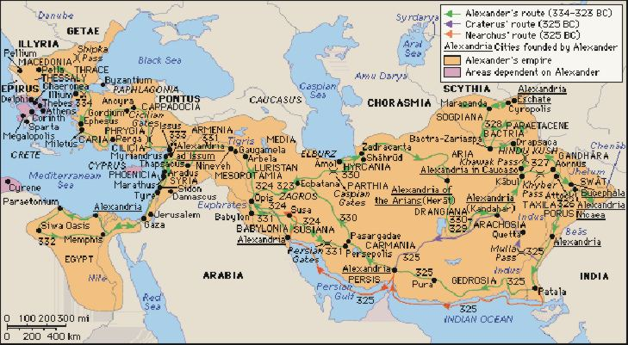
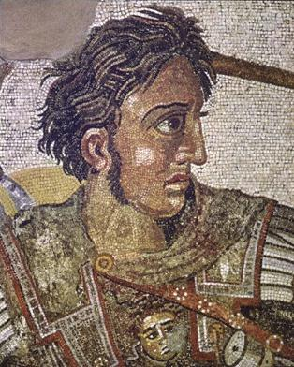
ALEXANDER’S EMPIRE

Slide 18
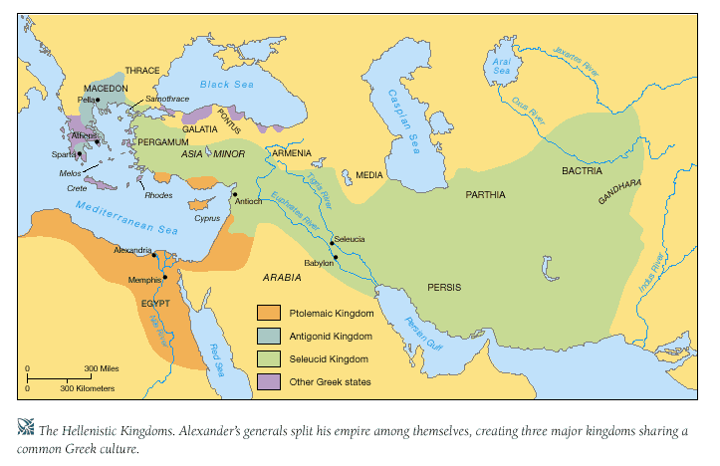
HELLENISTIC WORLD

Slide 19
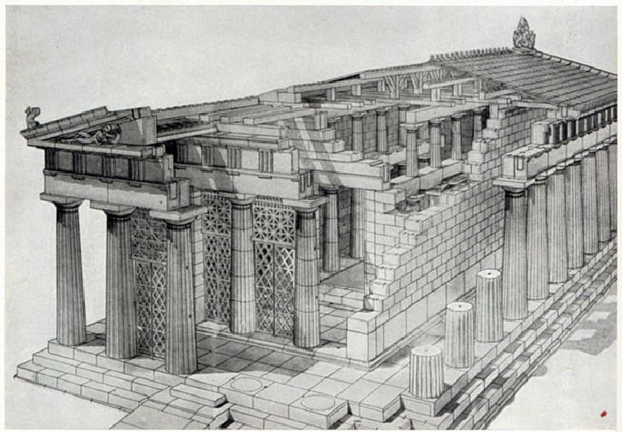
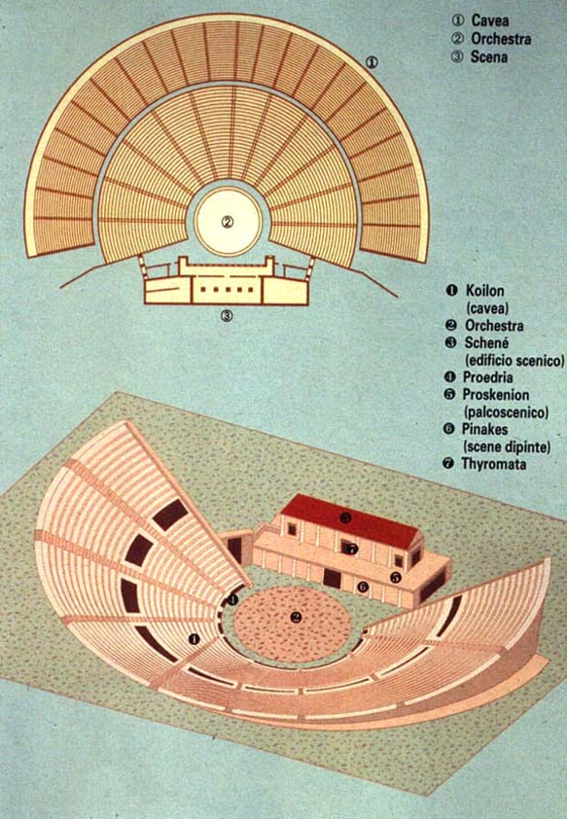
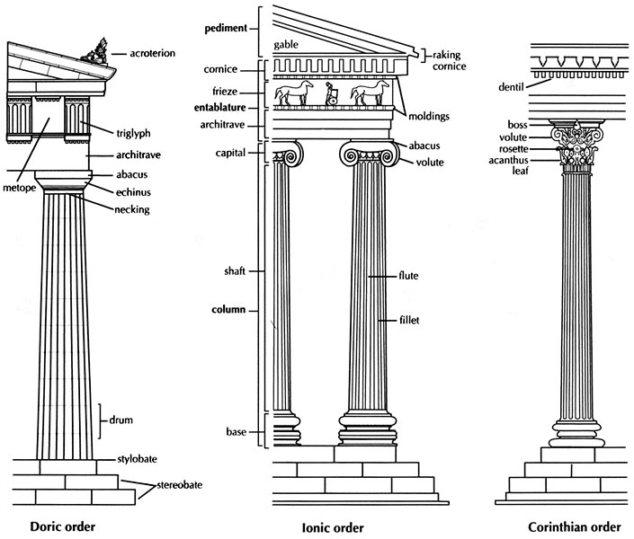
TEMPLES AND THEATRES

Slide 20
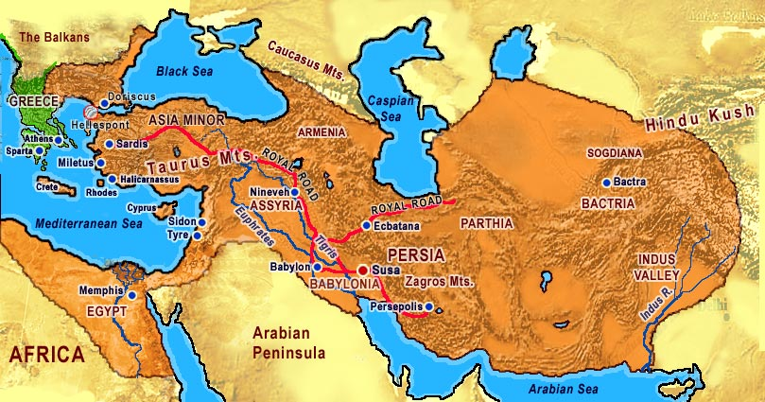
THE PERSIAN EMPIRE

Slide 21
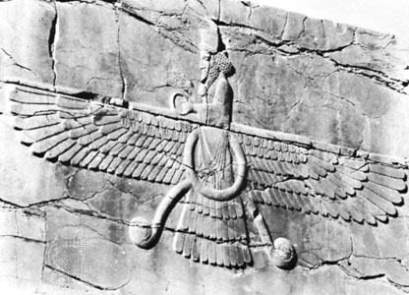
Persian Empire: 550-330 BCE
From modern Iran, largest empire to this date in history
Took over Neo-Assyrian empire
Medes: Persians who challenged Neo-Assyrian rule
Empire: Greece to India, as far north as Caucasus Mntns, as far south as North Africa
Cyrus I: Founder – conquers Anatolia/Babylonia.
Lets Jews in OT go home. (end of Babylonian Captivity)
Darius I: Organizer & Lawgiver Divides empire into 23 satrapies (satrap = governor related to royal family)
satrap: collect taxes, oversee territory, lots of autonomy further from the capital
Conquered Indus
Decentralized system. Conquered lived according to own traditions.
Est. new capital @ Persepolis
Zoroastrianism – Heaven/Hell, 1 supreme god, reward/punishment, “messiah.” Monotheistic polytheism – Ahura Mazda – supreme deity, over lesser deities.
Standardized coins, big empire, roads, stability brought forth good trade

Slide 22
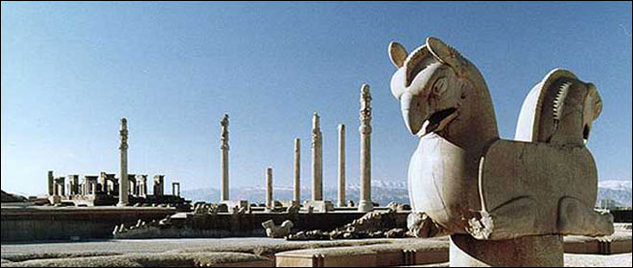
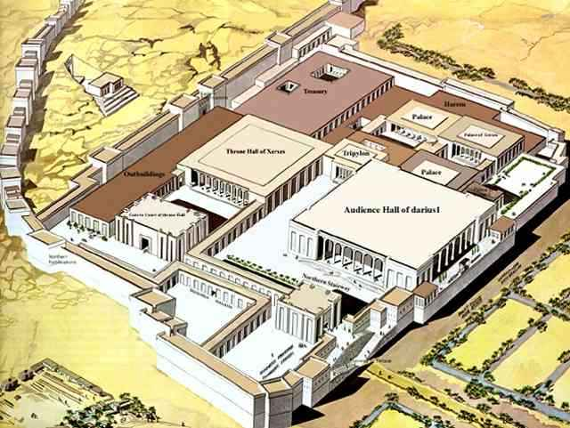
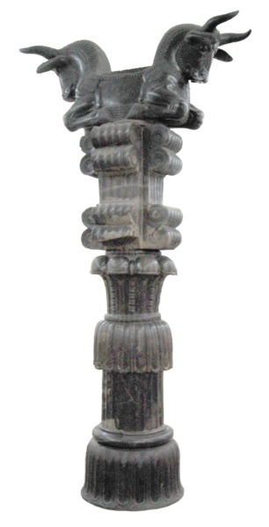
PERSEPOLIS

Slide 23
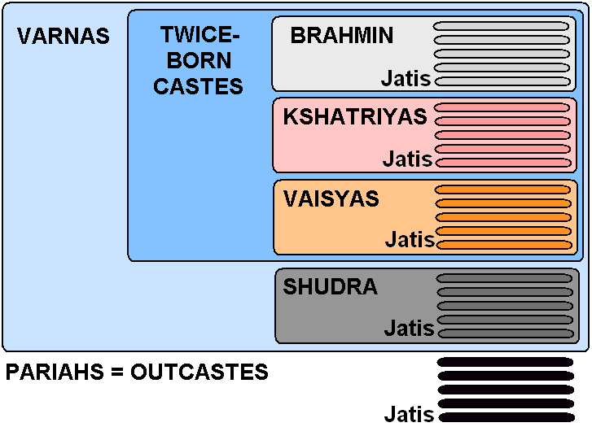
Classical India
Pre-classical India
Indus->Aryans, or Harappan Age-> Vedic Age
Varna: 4 social classes (castes)
Priests/scholars (Brahmin), warriors/govt officials (Kshatriya), merchants/artisans (Vaishya), peasants/workers (Shudra)
5th class: untouchables, given demeaning jobs
Rigid social hierarchy threatened by 8th Cent BCE
Brahmins – most powerful class
Jainism – nonviolence, self0denial, value of all living things
Buddhism – Siddhartha (Kshatriya)
Four noble truths: life is suffering, suffering comes from desire, suffering will end if desire ends, way to end desire is the Eightfold path.
Reach nirvana at the end cycle of reincarnation
Will spread to much of India, Asia after 483 BCE
Mahayanas – worshipped Buddha as a god & bodhisattvas (enlightened men and women who gave up nirvana to help lead others). Central/Western Asia.
Theravadas – no Buddha images, no worship of Buddha. Basics. SE Asia.

Slide 24
Classical India (cont.)
Buddhism’s popularity forces Vedic religion to evolve to Hinduism
Brahmins – still powerful, but gave people more personal connection to gods.
Hinduism borrowed much from Buddhism, even drove it from its land of origin.
Outside pre-Mauryan intrusions: Persians – 520 BCE(Indus satrapy), Alexander – 327 BCE (left local rulers to their own)
Political unification – tough in India
Geography, rigid social hierarchy, diverse languages, customs, varied economies, castes
324-184 BCE – Mauryan Empire – all of India except southern tip
Founded by Chandragupta Maurya – Arthrashastra (political handbook)
Coinage, govt controlled mines, large army, ¼ of peasantcrops paid to king
Spoils system – gave positions to allies/relatives
Ashoka – most famous Mauryan. Est. new capital at Pataliputra
Brutal in warfare, extends Mauryan empire to its height
Reflects on brutality, gives it up for nonviolence & tolerance of Buddhism
Moral codes inscribed on pillars throughout empire
Roads/maritime trade routes made India a hub for trade from SE/Central Asia/China w/Mediterranean, Middle East, even the Philippines
Collapsed due to outside invaders, high cost of empire/maintaining borders

Slide 25
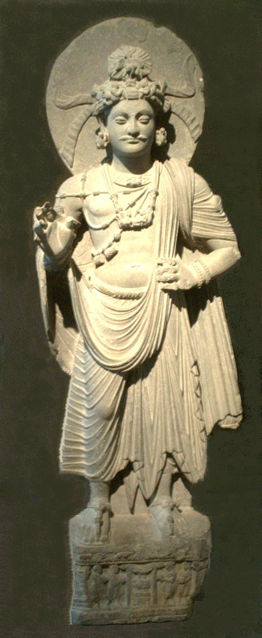
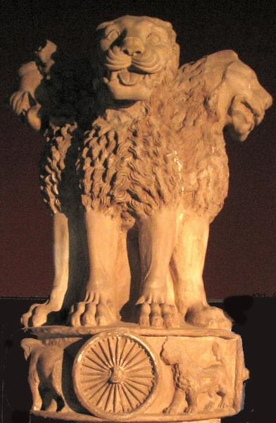
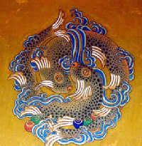
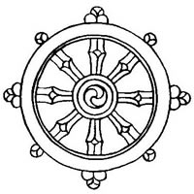

Slide 26
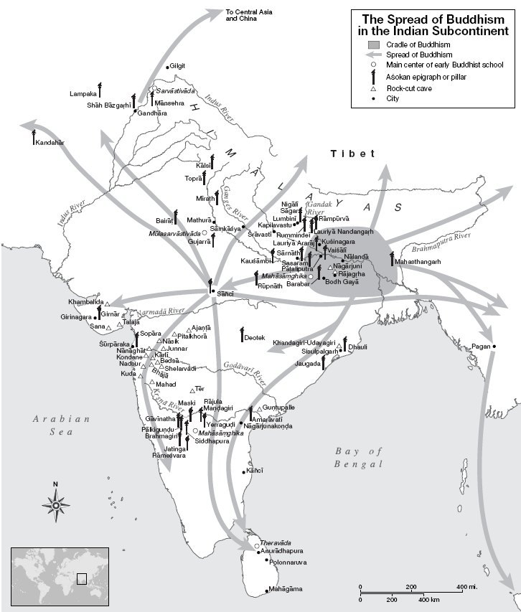
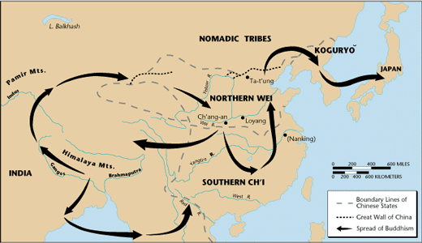
SPREAD OF BUDDHISM

Slide 27
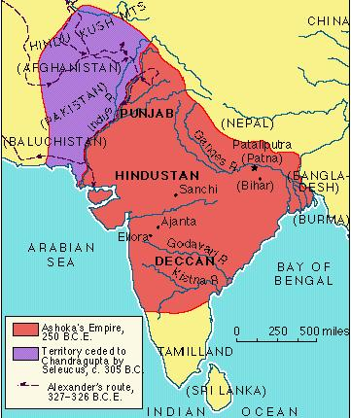
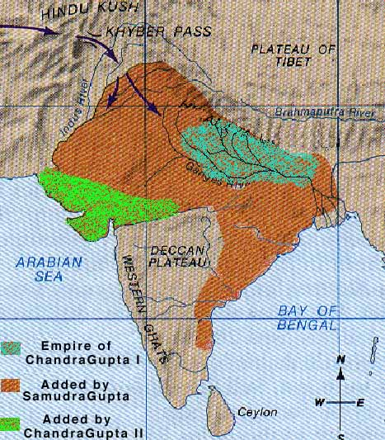
Mauryan Guptan

Slide 28
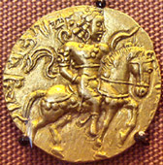
Classical India (cont.)
Gupta Empire (320-550 CE) – Golden Age of Hinduism
Leaders controlled agriculture/mining like Mauryans
Subjects donated labor for big projects
Trade/industry brought wealth to shudras/vaishyas
More decentralized than Mauryans
Local leaders were autonomous
But, could keep some profits from trade
Gave them incentive to stay loyal to Guptas
Big army helped keep order, but wasn’t enough
Invented concept of ‘0’ (zero). AKA the concept of “David Jensen”
Invented “Arabic” numerals
Collapsed after Huns attacked in 550 CE. Result: fragmentation
Women in Classical India: role changed w/economic changes
Increased trade->urban middle class->value on property-> women couldn’t own property
Expected, like under Confucianism, to obey male family members
Sati –throwing one’s self on your husband’s funeral pyre
Buddhism/Jainism – gave women a little more freedom than Hinduism
Upper class women could be educated

Slide 29
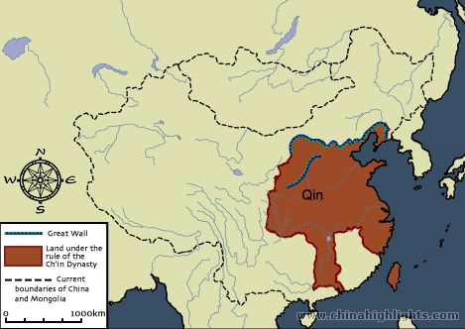

Slide 30
Classical China – more Qins than a Chinese phonebook
End of Zhou: Warring States Period
Political fragmentation, feudalism, warlords!
Qin (350-206 BCE) – led by Shi Huangdi defeat Zhou
China’s first empire – unification!
Legalism – strict rule, little care for subjects
Totalitarianism – state/leader is the end of all things. Controls political life, economics, military, religion, etc.
Slavery abolished to create free labor/taxable citizens/military conscripts
Standard coinage, laws, 1000’s of miles of road, canals, walls
Helped secure & consolidate power @ home & vs. outsiders
Also held noble sons hostage, destroyed noble castles
Had 460 Confucian scholars buried alive for opposing the Qin.
Iron technology. Used in warfare, agriculture.
After Shi Huangdi dies, people revolt vs. oppressive Qins
Qin royal afterlife: Terracotta soldiers protected Shi Huangdi’s tomb. All individual faces.

Slide 31
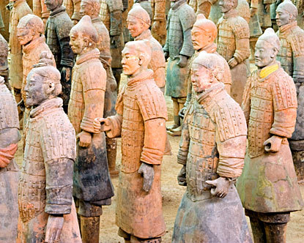
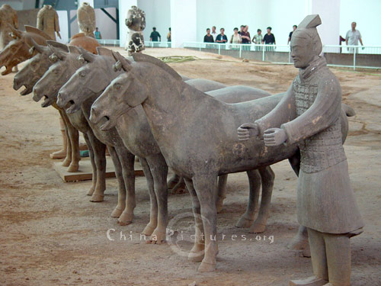
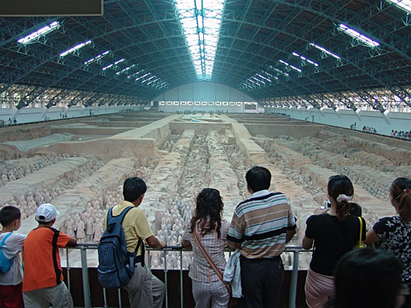

Slide 32
Classical China (cont.)
Han dynasty (206 BCE – 220 CE)
Located by eastern river valleys
Tax system: based on crops
Men donated 1 month of labor to build infrastructure & 2 years military service
Confucianism – clear hierarchy, ppl saw themselves having a role in the family/society
Expansionist: conquered modern Vietnam & Korea
Emperor: Son of Heaven. Just like the Zhou.
Local leaders: taxed, organized labor, defended empire
Government meritocracy: young men went to universities in order to get gov’t positions. Really, only the wealthy had time/money to send sons to university. They then became part of a massive bureaucracy.
Result: Peasants, alienated by high-ranking Confucianism, turn to Daoism, which was principally opposed to Confucianism.

Slide 33
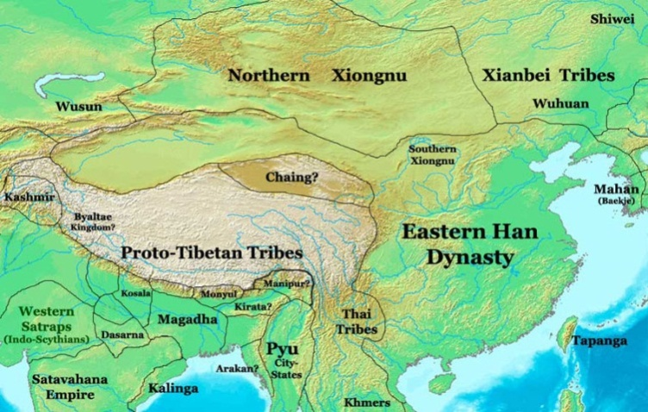
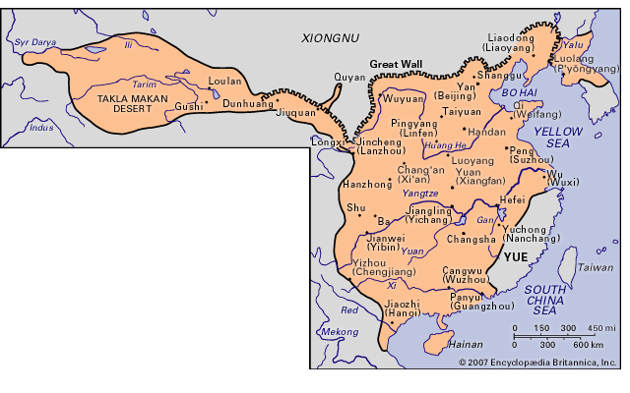
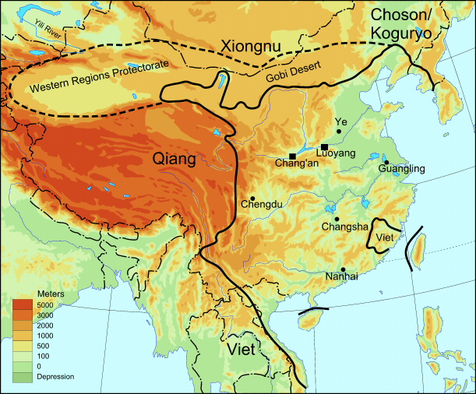
MAPPING HAN CHINA

Slide 34
Classical China (cont.)
Women under the Han: subjugated
Ban Zhao – Admonitions for Women
Achievements of Han: crossbow, cavalry, horse collar, road system, watermill, paper, silk & the silk road!
Fall of Han: empire was too costly. Too much frontier, too much corruption in government, too few troops left to garrison, too many regional warlords, & peasant rebellions.
Expansionist expeditions wasted gov’t coffers, defense money spent fighting outside nomads
Wide gulf between rich and poor.
Land possessed by few people, unlike early Han.
China fragments once again after the Han

Slide 35
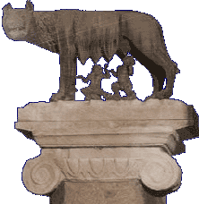
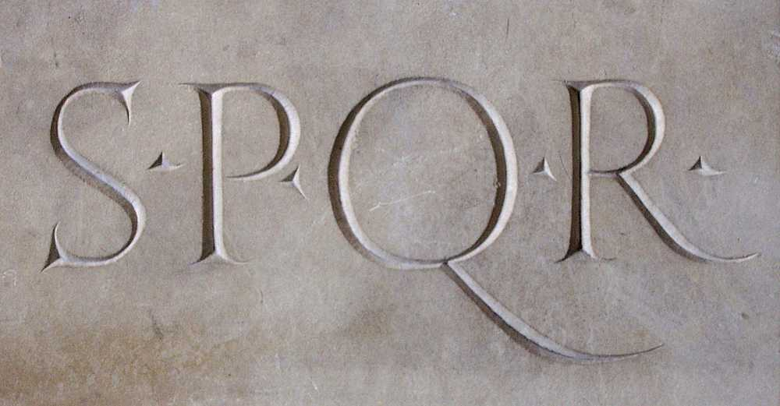
THE ROMANS
FROM KINGDOM TO REPUBLIC TO EMPIRE

Slide 36
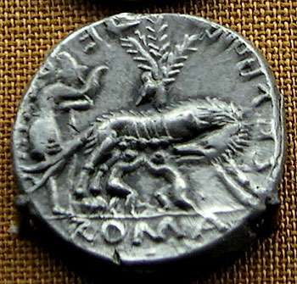
EARLY ROME
The Etruscans
Probably migrated from Anatolia
Dominated Italy from the 8th to 5th centuries B.C.E.
City-states were constantly at war
Similar in own way to Greek society
Arch, religion, alphabet, early traditions given to Rome
Declined, attacked by Gaul and defeated by Greek fleets
Romulus and Remus
Legend: twins rescued by a she-wolf
Founded Rome in 753 B.C.E.
Indo-European migrants settled in Italy from 2000 B.C.E.
Came from Latins, a tribe of the Italics
The kingdom of Rome
A small kingdom on the Tiber River, ruled by monarchies
Easy access to the Mediterranean, trade routes led to Rome
Agriculture, warfare were typical
Society dominated by aristocracy called patricians

Slide 37
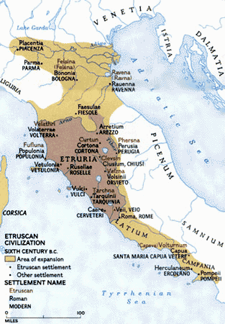
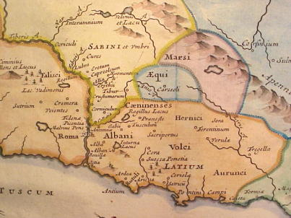
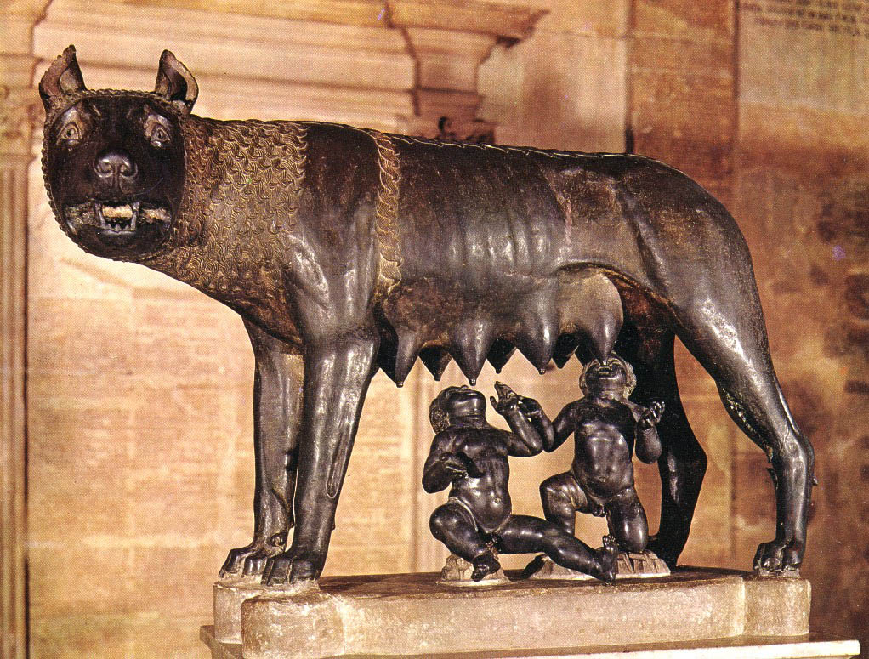
THE WORLD OF EARLY ROME

Slide 38
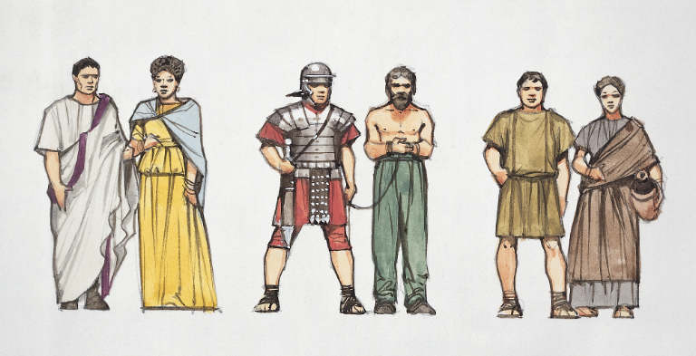
EARLY ROMAN REPUBLIC
Establishment of the Republic
Rome nobility deposed the last Etruscan king in 509 B.C.E.
Republican constitution
Included two consuls: civil and military
Consuls elected by an assembly dominated by the patricians
The Senate advised the consuls and ratified major decisions
Senate and consuls represented the interests of the patricians
Conflicts between patricians and plebeians
Plebeians' threat to secede from Rome
Patricians granted plebeians the tribunes
Tribunes' power to intervene and veto decisions
Tribunes dominated Roman politics, early 3rd century B.C.E.
In times of crisis, ruled by short-term dictatorship
Elected for six month term
Given unlimited power

Slide 39
ROMAN REPUBLICAN GOVERNMENT
Monarchical | Aristocratic | Democratic
2 Consuls and Magistrates | Senate (Senators) | Assembly of Tribes (10 Tribunes)
Directed government Control army Acted as judges Could issue edicts Acted as chief priest | Controlled state budget Could pass laws | Approved/rejected laws; Decided on War Tribune could veto actions of magistrate Acted as final court
Basis of power: possess imperium, the right to rule need for leadership | Basis of power: members were richest men in Rome. | Basis of power: provided most of the soldiers
Limits on power: one year term each could veto | Limits on power: could not control army; needed majority as soldiers. | Limits on power: Could not suggest laws; often paid as clients by the elite

Slide 40
EXPANSION OF REPUBLIC
The Legion gave Rome incredible power
Roman military formation of 5,000 men
Extremely organized; all officers well trained
Shields, swords (two edged) were revolutionary
Subunits could operate on own without central commands
Consolidated position in Italy BY 4th centuries B.C.E.
Conflict with Italics and Greeks in S. Italy
New Roman colonies founded – with Roman rights
Created alliances with Italics – given Latin rights
Expanded Roman territory to include choice lands
Makes local aristocrats Roman citizens, allow to retain their lands
The Punic Wars (264-146 B.C.E.)
Battled descendants of Phoenicians for control of Sicily, Spain
Built navy to challenge Carthage
Defeated Carthaginians and conquered Africa
Conflicts with Antigonids and Seleucids,
Five major wars
Created alliances as with Italy, colonies of Roman settlers
Rome became a preeminent power in the Mediterranean

Slide 41
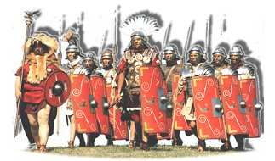
ROMAN LEGION

Slide 42
THE PUNIC WARS
Hannibal’s Elephants
Hannibal
Scipio
Africanus

Slide 43
THE END OF THE REPUBLIC
Social Tension
Long wars ruined most small farmers
During war could not plant or harvest, debts increased
Forced to sell land to patricians, move to city as day laborers
Poor often sold into slavery
Increased slavery more profitable than hiring Roman poor
Migration of poor to cities produced lawlessness
The Gracchi brothers
Tiberius Gracchus represented interests of Rome's lower classes
Served as a tribune, passed a law that set limits for landholding
Assassinated in 132 B.C.E.
The younger brother, Gaius Gracchus, continued the reform
Was branded as a outlaw, killed by mercenaries
Republican government could no longer maintain power balance
Marius and Sulla
Gaius Marius recruited a private army from landless residents
Conservative aristocratic class supported Lucius Cornelius Sulla
Both raised troops illegally under Roman law
Civil War
Marius seized Rome in 87 B.C.E.
Sulla seized Rome in 83 B.C.E. after Marius died, 5 years of terror

Slide 44
EXPANSION OF THE REPUBLIC

Slide 45
FOUNDATION OF EMPIRE
Julius Caesar
Marius's nephew
Favored liberal policies and social reform
Gained fame by sponsoring public spectacles
Conquered Gaul, became more popular
First Civil War
Seized Rome in 49 B.C.E.
Claimed the title "dictator for life," 46 B.C.E.
Social reforms and centralized control
Assassinated in 44 B.C.E.
Second Civil War to Avenge Caesar’s murders
Augustus
Octavian, nephew of Caesar, brought civil conflict to an end
The Senate bestowed upon him the title Augustus, 27 B.C.E.
Augustus's administration
A monarchy disguised as a republic
Preserved traditional republican forms of government
Took all the power into his own hands
Created a new standing army under his control
The imperial institutions began to take root

Slide 46
EMPIRE AT ITS HEIGHT

Slide 47
THE PAX ROMANA
Roman expansion had effects in Gaul, Germany, Britain, Spain
Romans sought access to resources
Built legionary camps to defend; Roman officials ran provinces
Provincial elite began to build estates and control resources
Came from two sources: Roman colonists, local ethnic elites
Elites became largely Romanized
Cities emerged, roads built, common currency, laws
Allowed locals to retain customs, traditions if paid their taxes
The pax romana
Meant "Roman peace," lasted for two and half centuries
Facilitated trade and communication
World linked from Mesopotamia to Atlantic Ocean
Roman roads
Roman engineers as outstanding road builders
Roads and postal system linked all parts of the empire
Roman law
Tradition: Twelve Tables enacted in 450 B.C.E.
Principle: innocent until proven guilty
Judges enjoyed great discretion

Slide 48
ROMAN ROADS

Slide 49
TRADE & URBANIZATION
Commercial agriculture
Owners of latifundia focused on production for export
Commercial agriculture led to economic specialization, integration
Slavery preferred over labor saving devices and paid labor
Mediterranean trade
Sea-lanes linked ports of the Mediterranean
Roman navy kept the seas largely free of pirates
The Mediterranean became a Roman lake
The city of Rome
Wealth of the city fueled its urban development
Statues, pools, fountains, arches, temples, stadiums
First use of concrete as construction material
Rome attracted numerous immigrants
City attractions
Public baths, swimming pools, gymnasia
Enormous circuses, stadiums, and amphitheaters
Other Cities
Most large cities were in Eastern part of empire
Eastern cities largely dominated by Greeks
Cities include Alexandria, Antioch, Athens, Pergammum, Thessalonika

Slide 50
CLASSICAL ROME

Slide 51
ROMAN FAMILY, SOCIETY
The pater familias
Roman family: all household members living together
Pater familias or "father of the family" ruled
Women wielded influence within their families
Many women supervised family business, estates
Wealth and social change
Rich classes built palatial houses, lavish banquets
Cultivators, urban masses lived at subsistence level
Poor classes became a serious problem in Rome and other cities
No urban policy developed, only "bread and circuses“
Merchants tolerated but not given much social recognition
Slavery
Slaves - 1/3 of Roman population
Chained together in teams, worked on latifundia
Spartacus's uprising in 73 B.C.E.
Working conditions for city slaves were better
Epictetus, an Anatolian slave, became a prominent Stoic philosopher
Urban slaves could hope for manumission
The gladiator or a slave trained to fight in the arena was popular

Slide 52
ROMAN WORLD VIEW
Veritas and Gravitas
Honesty and Seriousness
Symbolized Roman cultural values
Roman Polytheism
Early deities: Jupiter, Mars, Ceres, Janus, Vesta
Newly adapted deities: Juno, Minerva
Borrowed, co-opted foreign deities into pantheon
Religion was agricultural, state oriented, important to family
Very little emotional attachment to gods
Greek influence represented by Philosophy
Stoicism appealed to Roman intellectuals
Cicero (106-43 B.C.E.) established Stoicism in Rome
Epictetus and Marcus Aurelius wrote extensively
Religions of salvation and Cults
Flourished in Rome and the Mediterranean basin
Roman roads served as highways for religious spread
Mithraism
Mithras, a god of sun and light in Zoroastrian mythology
Roman soldiers adapted it, associated it with military value
Moral teaching of Mithraism, only for men
Goddess Cybele and goddess Isis were also popular

Slide 53
JUDAISM & CHRISTIANITY
The Jews and the empire
Jews considered state cults to be blasphemy
Romans ruled through Jewish elites, tolerant of Judaism
Constant rivalry between Pharisees, Sadducces, Zealots
Roman Jewish provinces ruled by client kings such as Herod
The Essenes
A new sect of Judaism, founded in Palestine during the 1st century B.C.E.
Strict moral code, baptism, and ritual community meals
Jesus of Nazareth
Charismatic Jewish teacher, taught devotion to God, love for human beings
The teaching "the kingdom of God is at hand" alarmed the Romans
Crucifixion in early 30s C.E.; Became "Christ," or "the anointed one"
New Testament and the Old Testament became the holy book of Christianity
Paul of Tarsus
A Jew from Anatolia, zealously preached his faith beyond Jewish communities
Was Roman citizen by birth in a Greek city; from Pharisee family
Paul who spread the faith in Mediterranean through missions
Was finally executed by Roman officials
66 – 70 CE
The Jewish War (66-70 C.E.) Roman forces defeated the Jewish rebels
Jews expelled Christians from the temple (from Judaism)

Slide 54
EARLY CHRISTIANITY
Roman repression
Peter and Paul both executed in Rome by Nero in 67 CE
Romans followed very tolerant policy: pay taxes, do not revolt
Christians refused to worship emperor, state gods = treason
Romans worried that Christians were anti-social
Some emperors persecuted Christians to increase patriotism
Christianity grew rapidly in the empire
Strong appeal to lower classes, urban population, and women
Accorded honor and dignity to lower standing individuals
Provided a sense of spiritual freedom
Taught the spiritual equality of the sexes
Promised future glory for true believers
All converts were equal
Most influential faith in Mediterranean by the 3rd century C.E
Egypt, Asia Minor, Greece heavily Christian including many aristocrats
Influence in west limited to cities, especially Africa
Armenia, Ethiopia, Egypt were first truly Christian countries
Rome became traditional head of church but not only leader
Primus inter pares = first among equals
Petrine Doctrine = Peter the first pope and head of the Church

Slide 55
CHRISTIANITY & ROME

