Slide 1
Medical Terminology

Slide 2
Word Parts Are the Key
Word roots, also known as combining forms, contain basic meaning of the term. Usually indicate the body part.
Suffixes usually indicate the procedure, condition, disorder or disease.
Prefixes usually indicate location, time, number or status.

Slide 3
Combining Vowels
Make the medical term easier to pronounce.
The letter O is the most commonly used combining vowel
When a word root is shown with a back slash and a combining vowel, such as cardi/o, this is referred to as a combining form.

Slide 4
Rules for Combining Vowels
A combining vowel is used when the suffix begins with a consonant such as rhin/o/plasty.
A combining vowel is not used when the suffix begins with a vowel such as neur/itis.
A combining vowel is always used when two or more root words are joined such as gastr/o/enter/itis.
A prefix does not require a combining vowel.

Slide 5
Suffixes
Added to the end of a word to complete the term. Most medical terms have to have a suffix.
Example: tonsill/o means tonsils. A suffix is added to complete the term and tell what is happening to the tonsils.
Tonsillitis is an inflammation of the tonsils
Tonsillectomy is the surgical removal of the tonsils.

Slide 6
Suffixes Meaning “Pertaining To”
Some suffixes complete the term by changing the word into an adjective (a word that describes a noun).
Cardiac means pertaining to the heart (cardi means heart and ac means pertaining to).
-ac -al -ar -ary -eal -ical
-ial -ic -ine -ior -ory -ous -tic

Slide 7
Suffixes as Noun Endings
Some suffixes complete the term by changing the word into a noun.
The cranium is the portion of the skull that encloses the brain (crani means skull and um is a noun ending).
-a noun ending
-e noun ending
-y noun ending
-um singular noun ending
-us singular noun ending

Slide 8
Suffixes Meaning “Abnormal Condition
Some suffixes have a general meaning of “abnormal condition or disease.”
Gastrosis means any disease of the stomach.
-ago abnormal condition, disease
-esis abnormal condition, disease
-ia abnormal condition, disease
-osis abnormal condition, disease
-ion condition
-ism condition, state of

Slide 9
Suffixes Related to Pathology
-algia means pain
-dynia also means pain
-itis inflammation
-malacia abnormal softening
-megaly enlargement
-necrosis tissue death
-sclerosis hardening
-stenosis narrowing

Slide 10
Suffixes Related to Procedures
-centesis surgical puncture
-ectomy surgical removal; excision
-graphy process of recording or record
-gram record or picture
-plasty surgical repair; plastic repair
-scopy visual examination
-ostomy create an opening
-otomy cut into; incision

Slide 11
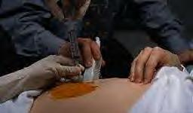
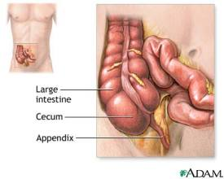
amniocentesis – surgical puncture of the amniotic sac
appendectomy – surgical removal of the appendix

Slide 12
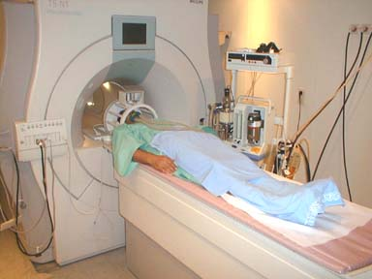
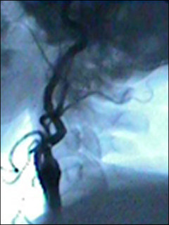
Arteriography – process of recording a picture of an artery or arteries
Arteriogram – record produced
by the arteriography

Slide 13
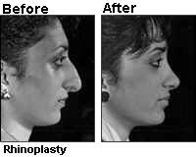
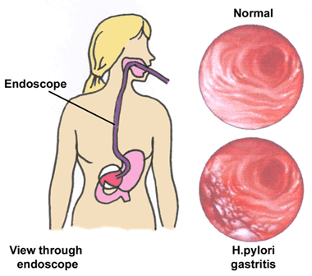
Rhinoplasty – surgical repair of the nose
GI endoscopy –
Visual examination of the inside of the GI tract (“end” means “inside”)

Slide 14
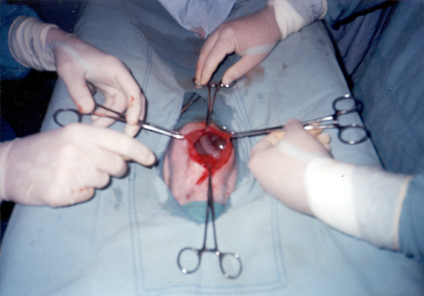
Colostomy – create an opening in the colon
Laparotomy – cut into the abdominal wall; incision in the abdominal wall

Slide 15
The Double RRs
-rrhage and – rrhagia bursting forth; abnormal excessive fluid discharge or bleeding
-rrhaphy to suture or stich
-rrhea to flow; abnormal flow or discharge
-rrhexis rupture

Slide 16
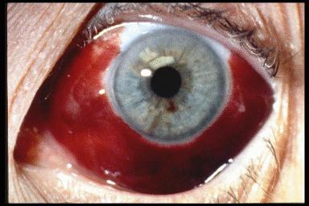
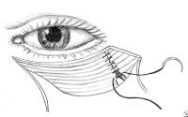
Hemorrhage - bursting forth of blood
(subconjunctival hemorrhage)
Myorrhaphy – suture or stitching of a muscle

Slide 17
Diarrhea – dia means through and rrhea is flow; to flow through….no picture, y’all know what it looks like!
enterorrhexis – rupture of the intestines (again, you can imagine what this would look like.)

Slide 18
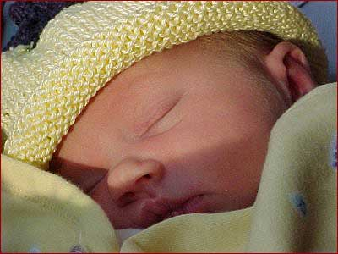
Prefixes
Prefixes are added at the beginning of the word to change the meaning of that term. The word root natal means pertaining to birth (nat=birth). These examples show how prefixes change the meaning.
Prenatal before birth
Perinatal surrounding or around birth. This is the time just before or during the birth.
Postnatal after birth

Slide 19
Just a few prefixes today!
EXAMPLE
ab- away from (abnormal)
ad- toward; in the (addiction means direction of drawn toward a drug or substance)
dys- difficult; painful (dysfunction;dysuria)
eu- normal; well good (euthyroid means a normal thyroid; euphoria means good feeling.)

Slide 20
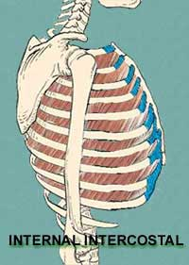
hyper- above normal, (hypertension) increased
hypo- decreased, below (hypotension) normal, deficient
inter- between or among (intercostal
muscles)

Slide 21
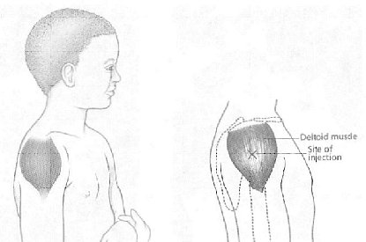
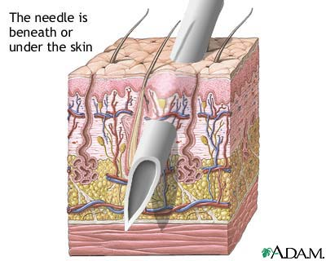
intra- within (intramuscular )
sub- under, below, less (subcutaneous)
Supra- above or excessive (supracostal)

Slide 22
Singular and Plural Endings
Many medical terms have Greek or Latin origins and there are unusual rules for changing some words from the singular form to the plural form.

Slide 23
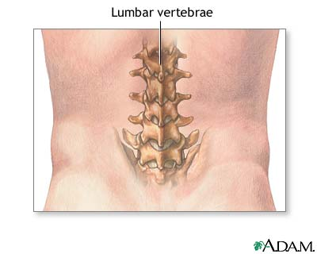
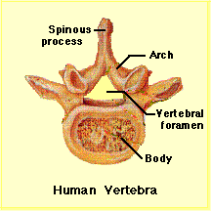
Guidelines to Unusual Plural Forms- If the terms ends in…….
“a” the plural is usually formed by adding an “e” vertebra to vertebrae
“ex” or “ix” change to “ices” appendix to appendices

Slide 24
If the term ends in “is,” the plural is formed by changing “is” to “es”
singular plural
diagnosis diagnoses
If the term ends in “itis,” the plural is form by changing “itis” to “ides”
singular plural
arthritis arthritides

Slide 25
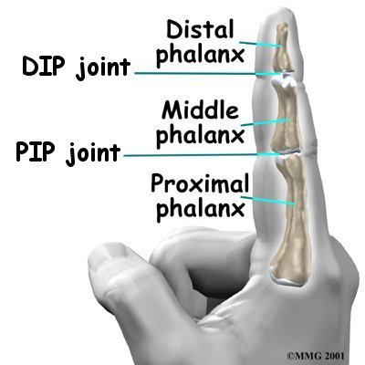
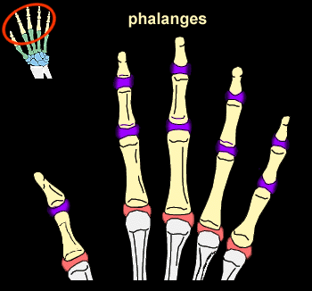
If the term ends in “nx”, the plural is usually formed by changing the “x” to “ges”
singular plural
phalanx phalanges

Slide 26
If the term ends in “on,” the plural is usually formed by changing the “on” to “a”
singular plural
criterion criteria
ganglion ganglia
If the term ends in “um,” the plural is usually formed by changing the “um” to “a”
singular plural
ovum ova

Slide 27
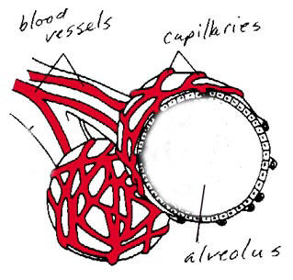
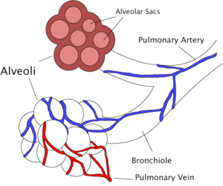
If the terms end in “us” the plural is usually formed by changing the “us” to “i”
singular plural
alveolus alveoli
(note the term “alveolar” on the diagram to the right…what does this mean?)

