Slide 1
Bell Work
What do the following mean?
Enzyme
Substrate
Denatured
Protein

Slide 2
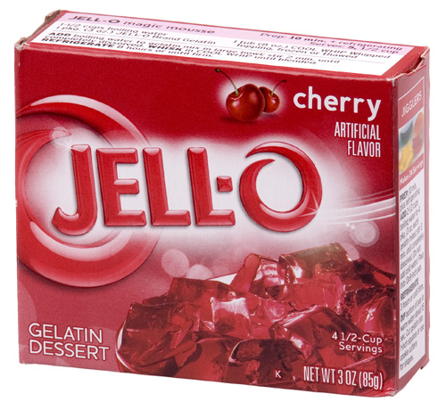
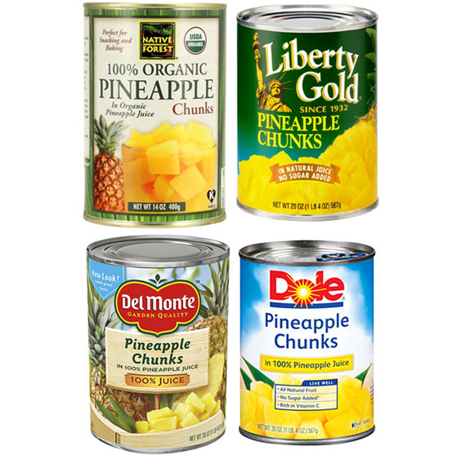
Pineapple Enzyme Lab

Slide 3
Background
Jell-O has some very unique qualities.
Changes from a hot liquid into a gel form we are all familiar with.
How does this happen? The large, string like protein molecules of gelatin wiggle around in the hot water solution. As the gelatin mixture begins to cool, the protein strands have less and less energy to wiggle, until eventually they eventually bond together forming what we know as Jell-O.

Slide 4
Background
The enzymes in some tropical fruits can break down protein.
Meat tenderizers have the enzyme, papain, which breaks down some of the tissues in the meat. We use it to soften up a tough piece of meat. The papain comes from the papaya fruit.
Pineapple has an enzyme called bromelain that also breaks down proteins.

Slide 5
Background
Pasteurization
Heat-treatment process discovered by French scientist Louis Pastuer in the 1860’s
He discovered that heating food to about 57º C (135º F) for a few minutes destroys bacteria and other microorganisms in foods and beverages.
This process is used widely today in the food industry for canned and bottled products.

Slide 6
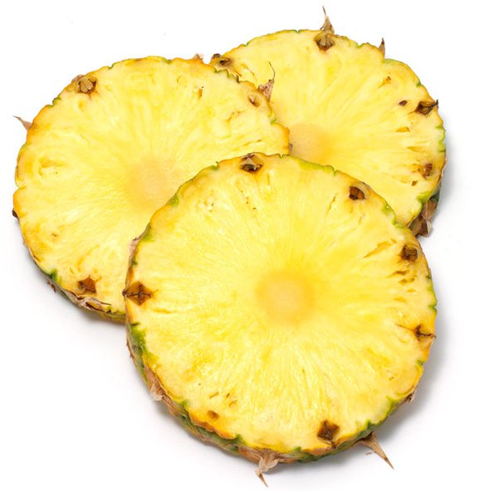
Purpose of Lab
To examine the effect of the enzyme bromelain on Jell-O
To discover how the process of pasteurization can impact the effectiveness of bromelain

Slide 7
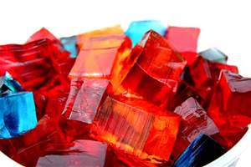
Questions
What will happen to the protein gelatin when I add pineapple?
Will fresh vs. canned pineapple make a difference?

Slide 8
Hypothesis
If,____________ then,________________. (Make a hypothesis statement for both fresh and canned pineapple)

Slide 9
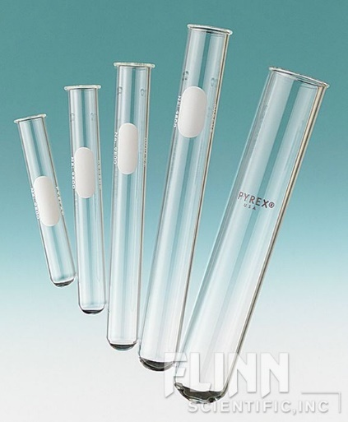
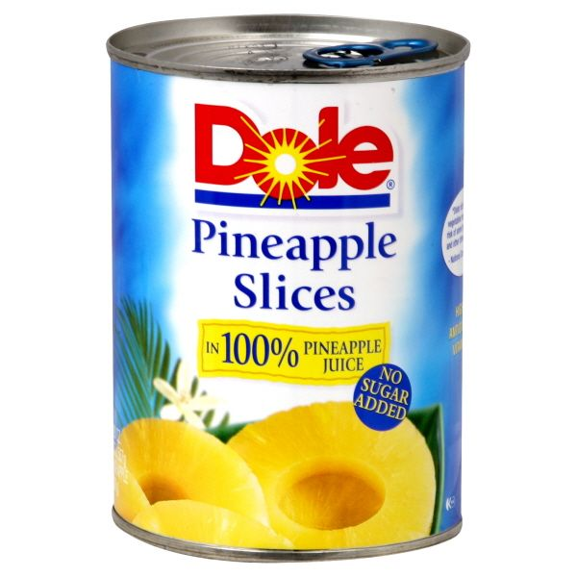
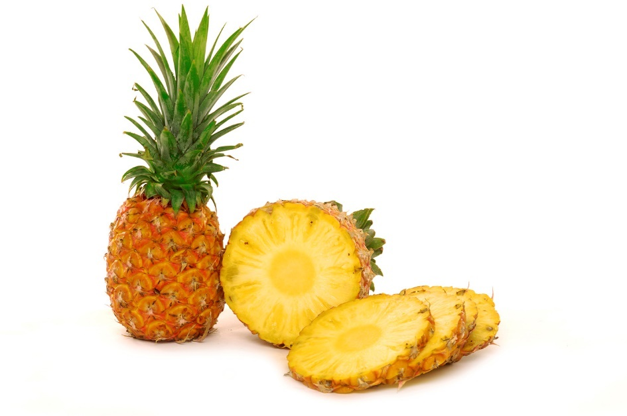
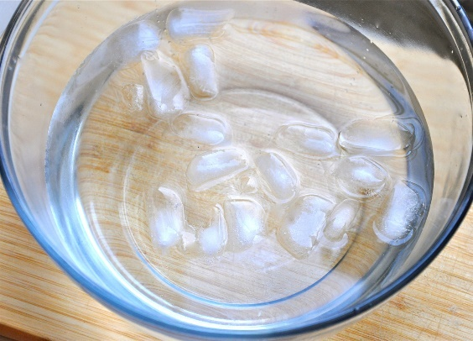
Materials
Three Test Tubes
Hot Gelatin
Fresh Pineapple
Canned Pineapple
Ice Water Bath

Slide 10
Procedure
l. Label your test tubes (A,B,C)
2. Cut a few equal sized pieces of fresh and canned pineapple. (The pieces should be just small enough to slide into your tubes.)
3. Place the different pieces of pineapple into the first two corresponding tubes. (A-Fresh, B-Canned, C-Only Jell-O)
4. Pour small amount of liquid gelatin into each of the tubes. (Enough to cover the pineapple - 1/4 full)
5. Mix the contents of the tubes by rolling them upright between the palms of your hands.

Slide 11
Procedure
6. Place all three test tubes into the ice water bath.
7. Every few minutes check to see if the gelatin is setting in the tubes. When test tube #3 has gelled firmly, you can remove all the tubes and compare the products.
8. Copy the data table below into your journal and record your observations/descriptions of the Jell-O.

Slide 12
Data Table
Test Tube #1 Jell-O + Fresh Pineapple | Test Tube #2 Jell-O + Canned Pineapple | Test Tube #3 Jell-O

Slide 13
Discussion Questions
1. Were your hypotheses correct?
2. Why did test tube #3 contain only gelatin?
3. What is bromelain?
4. What was the substrate that the enzyme bromelain acted on?
5. Was there any difference between the fresh and the canned pineapple results? Why do you think this was the case?
6. What does it mean to say that the bromelain was “denatured” during the canning process? What did this cause to happen?
7. Would it be a good idea to add pineapple to your Jell-O? If so, which type of pineapple? Why?

Slide 14
Pineapple Post Lab
What was the control group in this lab?
Why did the Jell-O with the fresh pineapple not gel?
Will bromelain (the enzyme in pineapples) break down carbohydrates? Why/Why not?
What is the function of enzymes in our bodies?
What does “denatured” mean when talking about an enzyme?

Slide 15
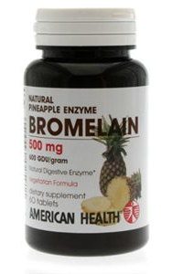
What you should have observed…
You Tube video (similar but not exactly the same)

