Slide 1
Regions of texas
High Plains Region ~ Location, Landforms, Important Cities

Slide 2
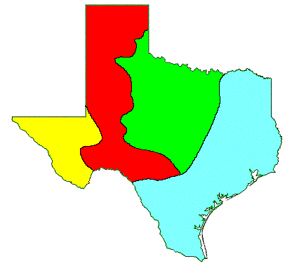
High plains region ~ location
Part of the Great Plains of the United States and Canada
Most of the Panhandle and Edwards Plateau
East & South borders are escarpments
Southwest border is the Mountains and Basins Region
High Plains Region

Slide 3
High plains region ~ panhandle
The northernmost area of Texas is called the Panhandle.
It is straight and narrow like the handle of a pan with the broader area of the state below it, like the bottom of a pan.
This region has mostly flat, grassy land or plains.

Slide 4
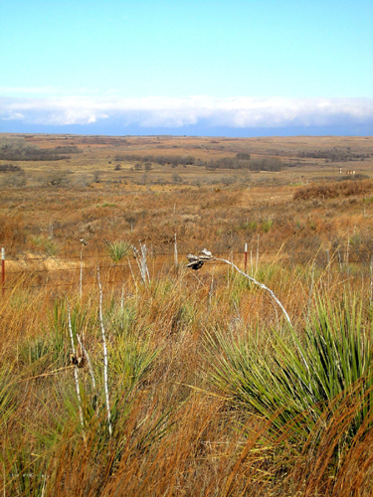
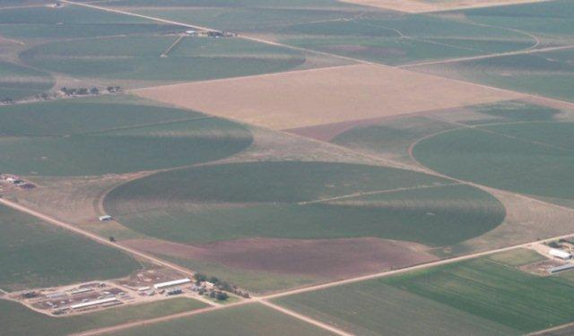
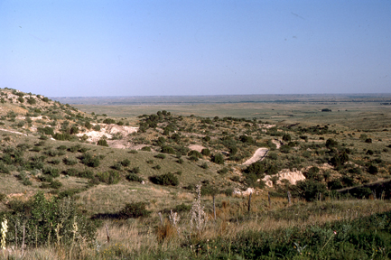
High plains region ~ location (cont.)
Geographic Subdivisions
High Plains
Edwards Plateau
Llano Basin
Panhandle plains
High Plains bluff
in Panhandle

Slide 5
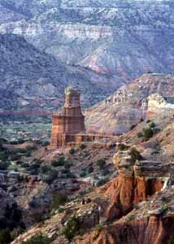
High plains region ~ panhandle (cont.)
The western and eastern parts of the Panhandle region divided by deep canyons.
Carved by rivers and their tributaries that wind their way through this area.
Palo Duro Canyon and Caprock Canyons State Parks are in this region.
They are sometimes called "inverteted mountains" since the land is relatively flat until you reach the long and steep canyons in the ground.

Slide 6
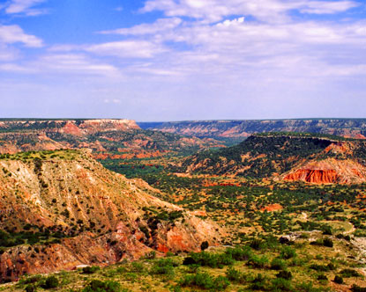
Palo Duro Canyon
Second largest canyon in the United States

Slide 7
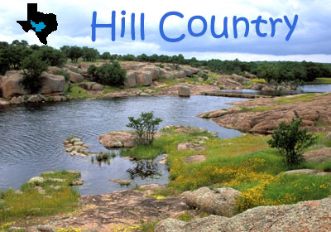
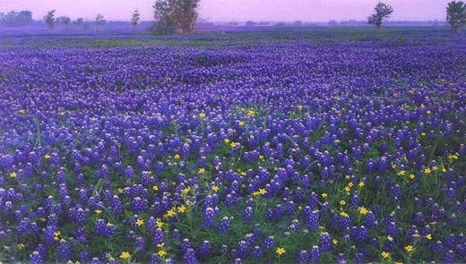
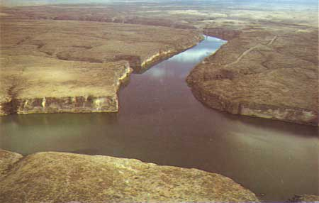
High plains region ~ Edwards Plateau
A plateau is high, flat land. Over many millions of years, this plateau has been eroded into a hilly terrain. There are many springs and some steep canyons in this area.
Texas Hill Country is partly in this region.

Slide 8
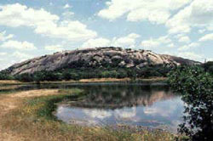
High plains region ~ llano basin
Also known as the central mineral region.
Home to some of the oldest rocks in Texas, the central mineral region contains unique minerals and rock formations.
Characterized by large granite domes, such as Enchanted Rock near Fredericksburg.

Slide 9
High plains region ~ landforms
Flat
Few trees
Canyons in North (Palo Duro Canyon)
Higher elevation than Central Plains
Cap Rock Escarpment
Edwards Plateau
Notes:
Reminder that an escarpment is a steep slope or long cliff that results from erosion or faulting and separates two relatively level areas of differing elevations.

Slide 10
High plains region ~ important cities
Amarillo & Lubbock in the Panhandle
Midland & Odessa in the Permian Basin
Kerrville, Fredericksburg, & Del Rio in the Edwards Plateau area

Slide 11
End of day 1 stop here! ☺

Slide 12
Regions of texas
High Plains Region ~ Climate, Plants, Animals

Slide 13
High plains region ~ climate
Dry air
Hot summers
Cold winters
Dust storms
16-20 inches of precipitation per year
Notes:
Compare to other regions: this one gets less rain

Slide 14
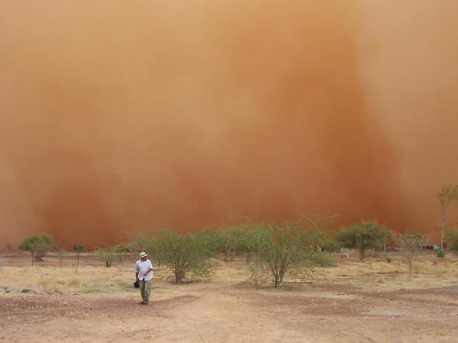
Dust storm
Notes:
As the wall of dust gets closer, you can’t see anything.

Slide 15
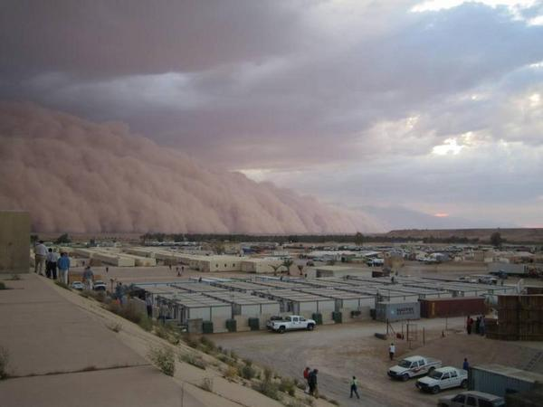
Dust storm

Slide 16
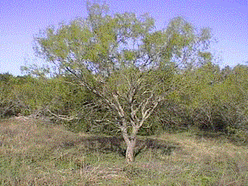
High plains region ~ plants
Short grasses
Mesquite, cedar, pecan, and oak trees in Edward Plateau area
Mesquite Tree
Notes:
Mesquite tree grown today for the bark in barbequing.

Slide 17
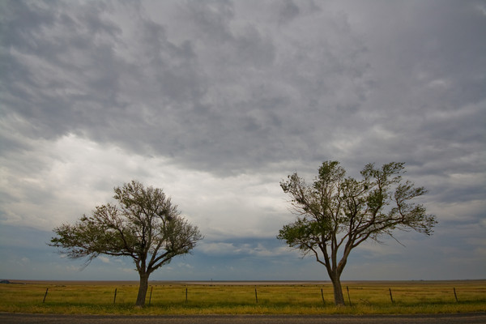
Two lonely trees on the Texas high plains west of Amarillo.

Slide 18
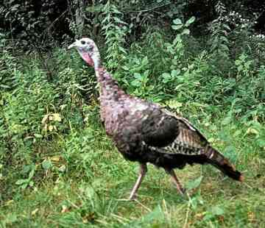
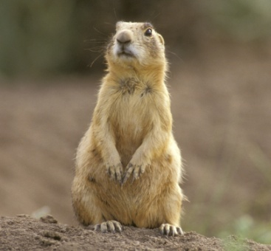
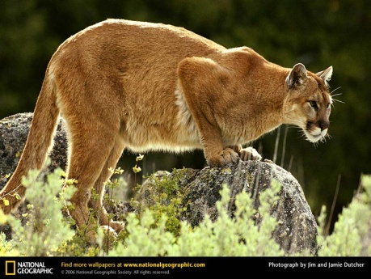
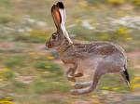
High plains region ~ animals
Deer
Wild turkeys
Mountain lion
Coyote
Prairie dog
Jackrabbit
Burrowing owl
Richard Seaman

Slide 19
End of day 2 Stop here ! ☺

Slide 20
Regions of texas
High Plains Region ~ Industry and Population

Slide 21
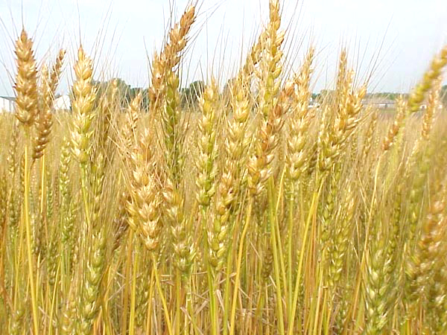
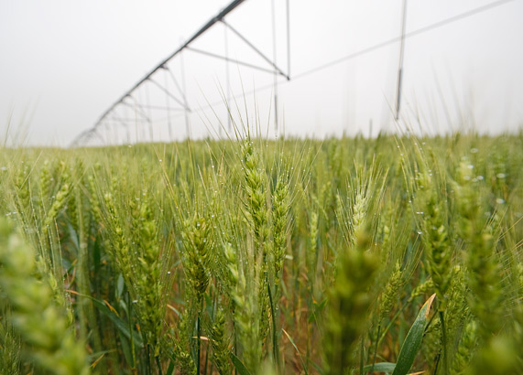
High plains region ~ industry
Farming - cotton, wheat (irrigation from wells)
Irrigation of wheat field

Slide 22
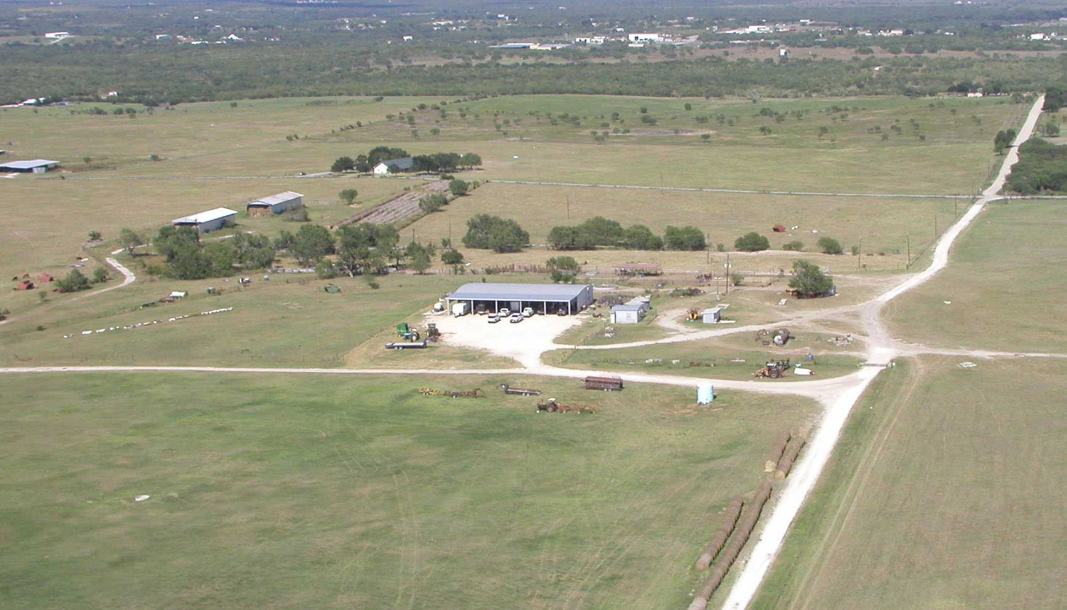
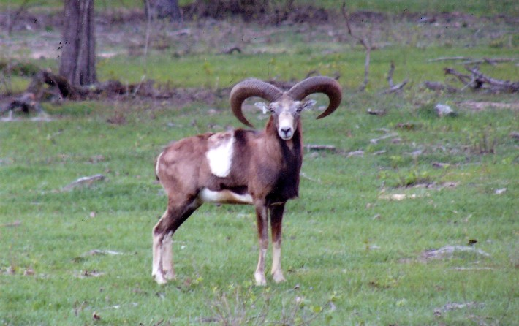
High plains region ~ industry
Ranching - cattle, sheep, goat

Slide 23
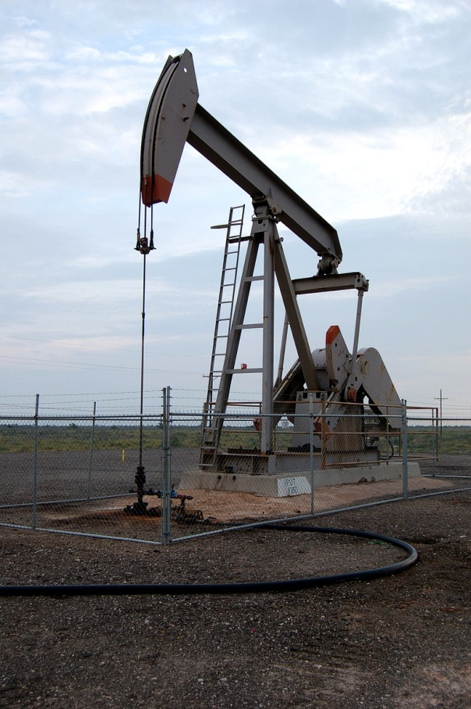
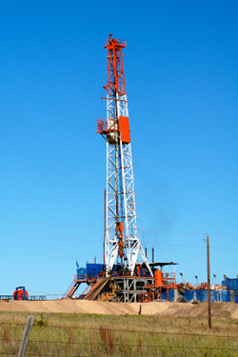
High plains region ~ industry
Oil and gas in the Permian Basin
Natural Gas
Gas Pump

Slide 24
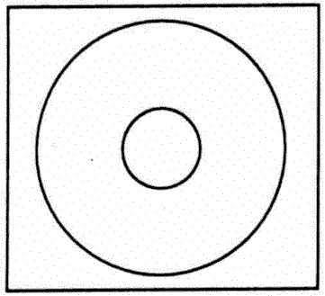
High plains region ~ Assessment
Create a Circle Map for this region.
Include words and illustrations that show your understanding of this region.

Slide 25
End of high plains region stop here! ☺

